Slide 1


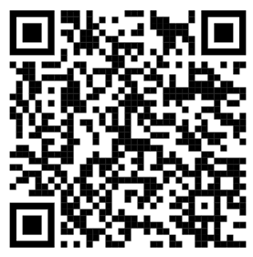
Managing Your (MY) Transition
participant GUIDE (PG)
Use the QR code on the right or the URL below to go to:
https://www.TAPevents.mil/Resources
2. Select the Participant Guide (PG) for the course.
Download and save the PG on your computer or email it to yourself if using a government computer.
NOTE: The corresponding page of the PG will appear in
the left, bottom corner of each slide.
PG, p. 1

Slide 2



2026 TAP CURRICULUM
MANAGING YOUR (MY) TRANSITION

Slide 3

HOUSEKEEPING INSTRUCTIONS
TAP Manager: Use this slide (or multiple slides) to provide site-specific information for the TAP week. Topics to consider including are parking, attendance, dress code, classroom behavior, WIFI password, computer checkout, COVID/sickness guidelines, cell phone usage, smoking area, restroom/lunchroom location, emergency evacuation plan, and site contact phone number.
HIDE or DELETE slide if not used.
Title Font: Franklin Gothic Medium, All CAPS. | Body Font: Calibri Body | Size: 18+
Color Codes: Dark Blue - RGB (R: 30, G: 61, B: 88) | Light Blue - RBG (R: 0, G: 176, B: 240)

Slide 4
  TAP Manager: Adjust the days and start/end times, if necessary, and add the course name for the 2-Day Track.
  Remove these instructions after editing the slide.
COURSE SCHEDULE
Day 1 Monday: 0800-1600
Day 2 Tuesday: 0800-1600
Day 3 Wednesday: 0800-1600
Days 4 & 5 Thursday & Friday: 0800-1600
  Managing Your (MY) Transition
  Military Occupational Code (MOC) Crosswalk
  Financial Planning for Transition
  VA Benefits and Services
  DOL Employment Fundamentals of Career Transition
  2-Day Track

Slide 5

DISCLAIMER
The information provided herein does not constitute a formal endorsement of any company, its products, or services by the U.S. Department of War (DoW). Specifically, the appearance or use of external hyperlinks does not constitute endorsement by the DoW of the linked websites, or the information, products, or services contained therein. The DoW does not exercise any editorial control over the information you may find at these locations. While this information provides informational resource material to assist military personnel and their families in identifying or exploring resources and options, the resources provided are not exhaustive.
All websites and URLs in this guide were active at the date of publication. However, web content is subject to change without notice. Users of this guide are advised to confirm information is current.
PG, p. 3

Slide 6


Slide 7







Activity: INTRODUCTIONS
What is your name?
Where do you plan to live after leaving the military?

Slide 8




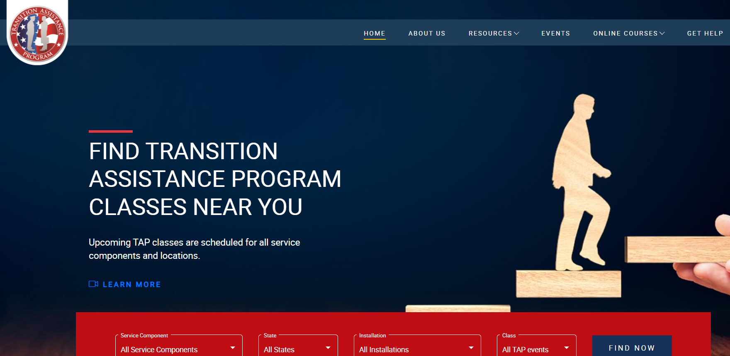
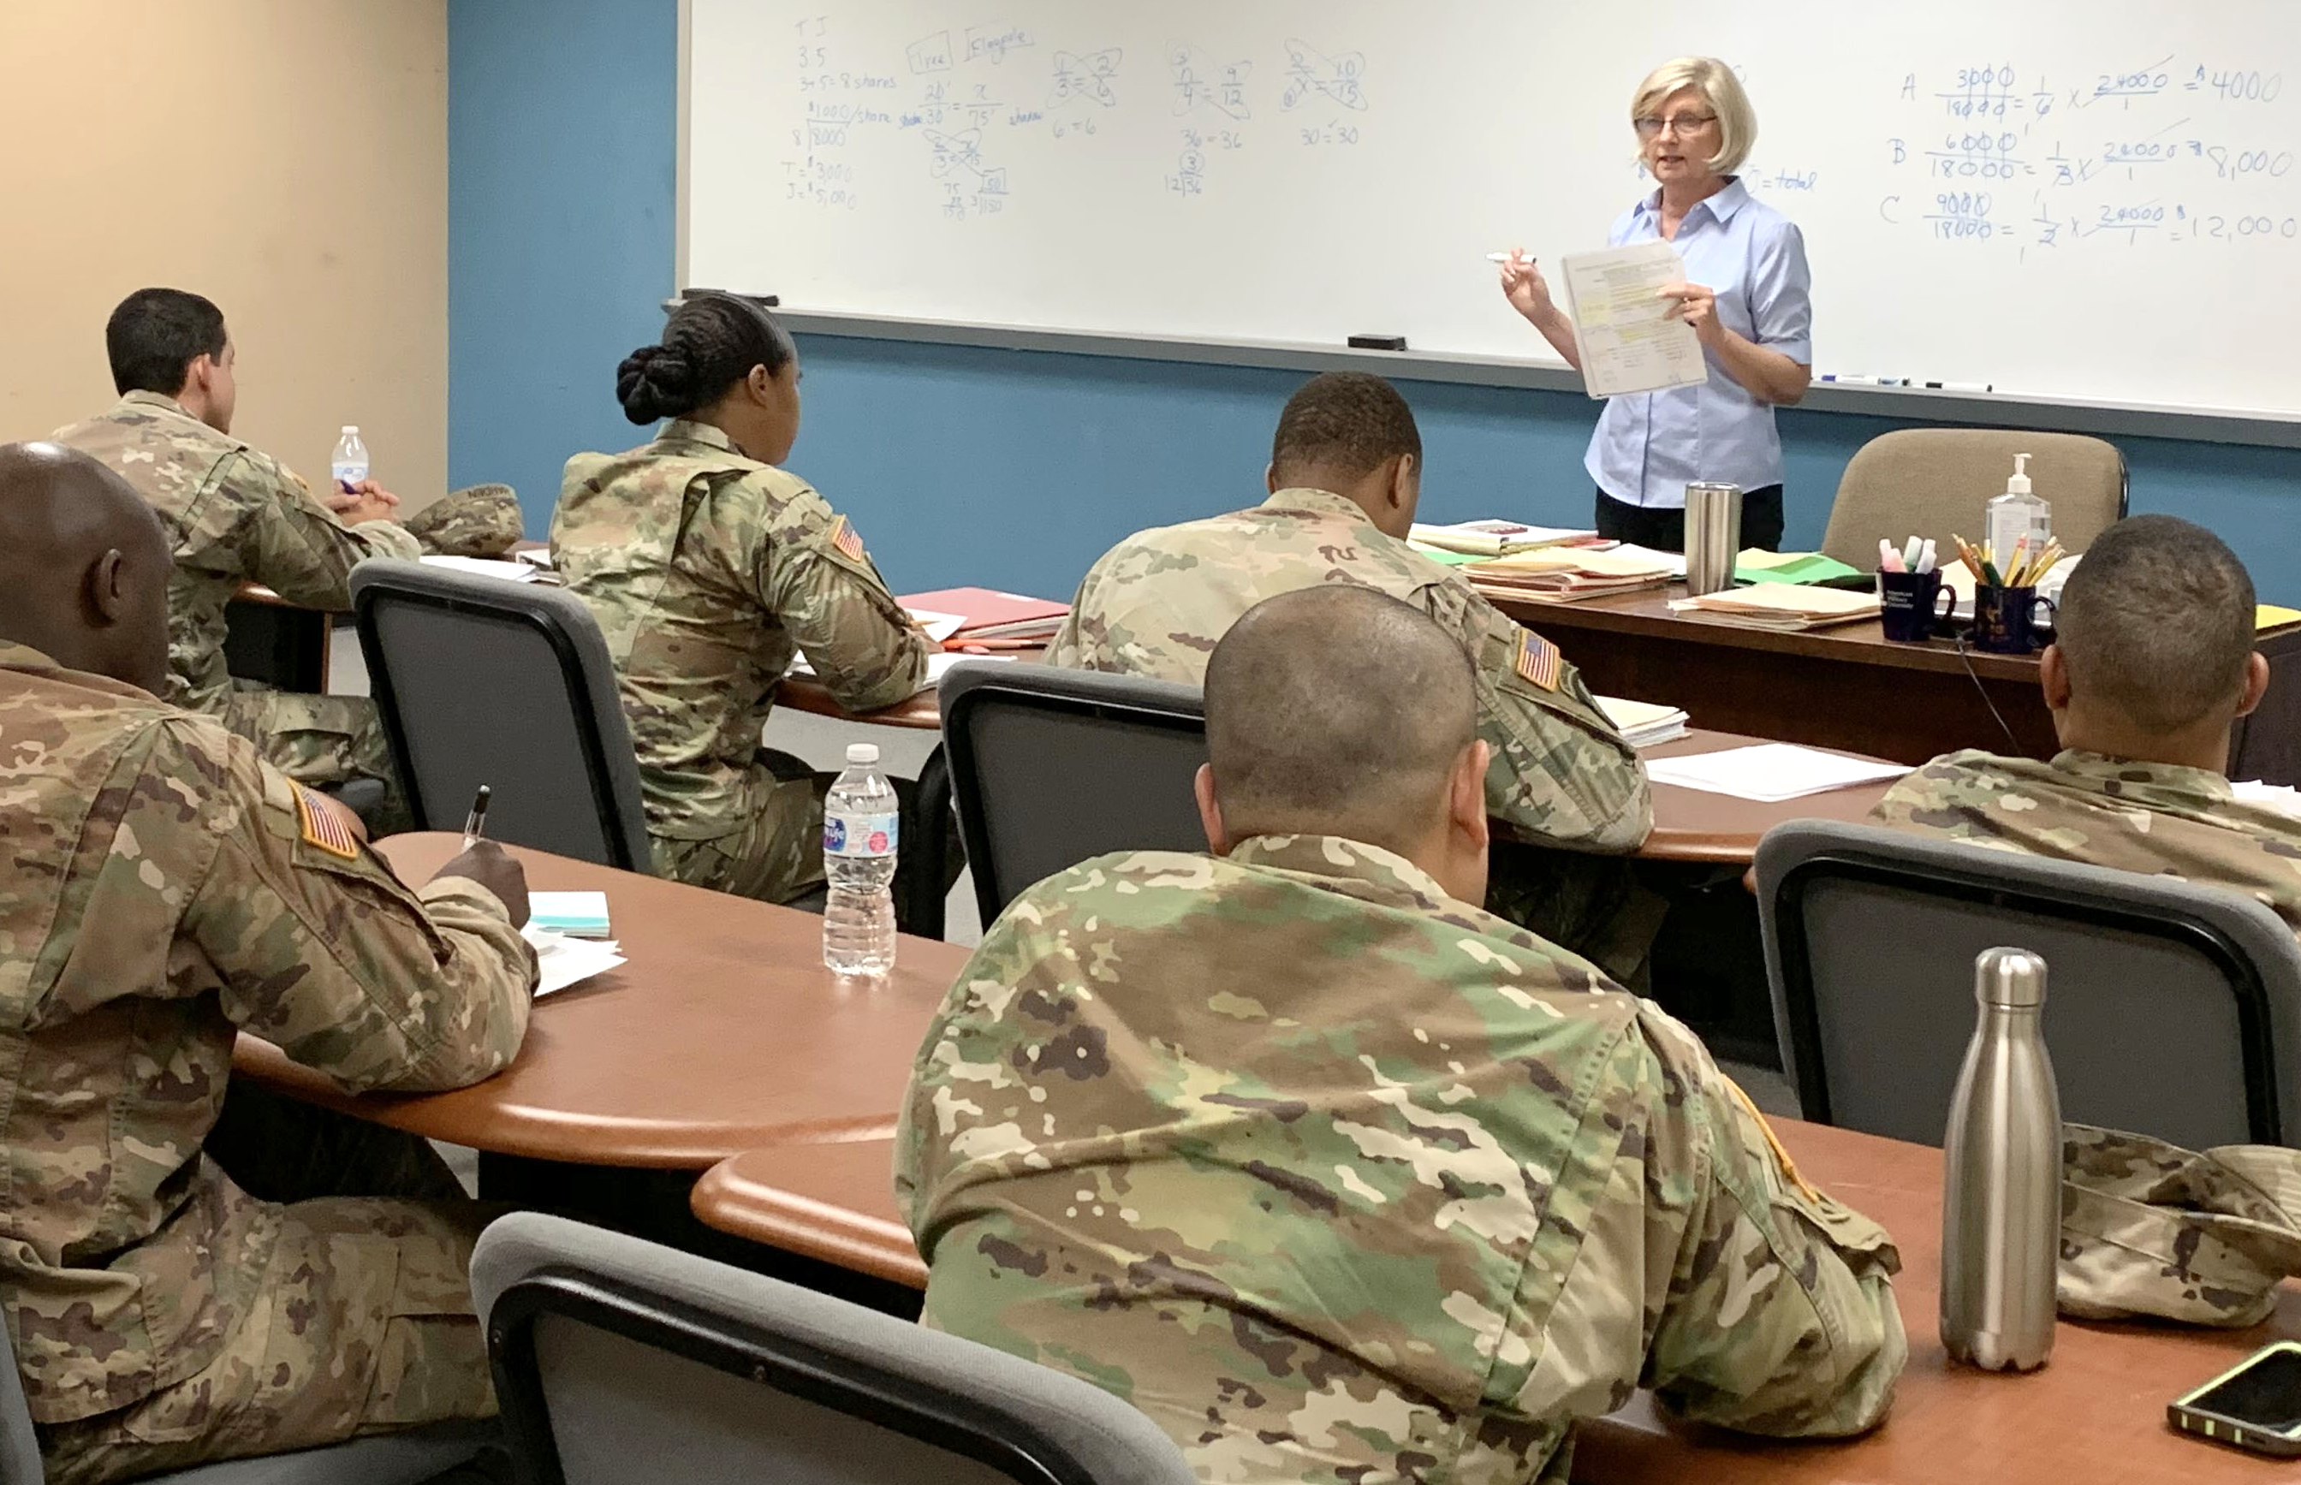
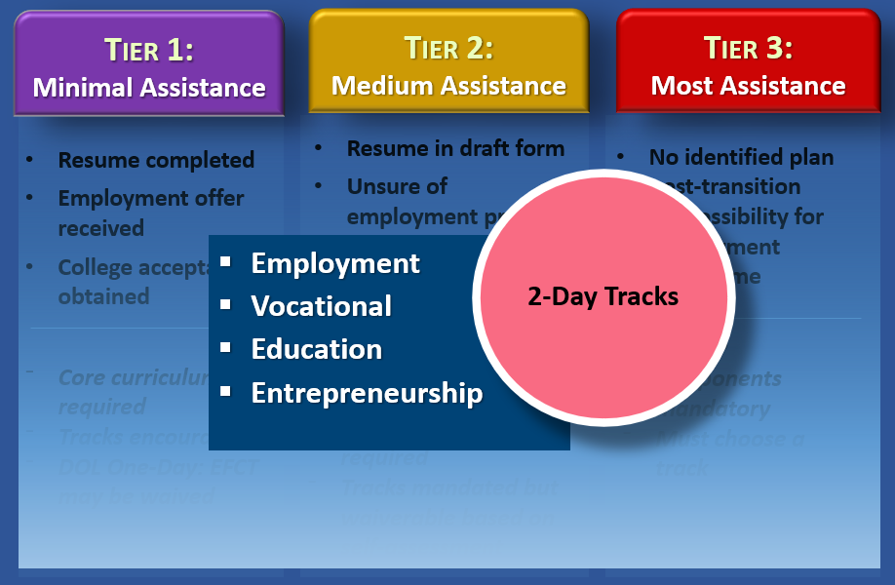
KEY TAP POINTS
Legislative program; content and length mandated by Congress
Foundational, standardized program founded on research
Reviewed by military Services and SMEs and updated annually
Implemented by the military Services
Customized to meet individual goals via tier assignment and 4 tracks
PG, p. 5

Slide 9
THE IMPORTANCE OF TAP
.5%
17%
7%
*Statistics provided by the U.S. Census Bureau
of the U.S. adult population was serving on active duty in 2021.
of the U.S. population were veterans in 1990.
of the U.S. population were veterans in 2020.
PG, p. 6

Slide 10
TAP OVERVIEW
You are here
Individualized Initial Counseling
Pre-Separation Brief
Managing Your (MY) Transition
NLT 365 Days
Begin TAP Courses
DOL Employment Fundamentals of Career Transition
VA Benefits and Services
Financial Planning for Transition
MOC Crosswalk
2-Day Tracks
Continuum of Service
Capstone
Employment
Vocational
Education
Entrepreneurship
NLT 90 Days
PG, p. 6
10

Slide 11


CAREER
READINESS
STANDARDS
Completed | CRS | Course/Brief
 | Start a personal self-assessment/Individual Transition Plan (ITP). | Individualized Initial Counseling/Pre-Separation Brief
 | Complete a Gap Analysis. | MOC Crosswalk
 | Prepare a criterion-based, financial spending plan. | Financial Planning for Transition
 | Register on VA.gov. | VA Benefits and Services
 | Complete a draft resume. | DOL Employment Workshop
 | Complete a comparison of technical training or higher education institutions. | DOL Career & Credential Exploration DoW Managing Your Education
 | Complete a continuum of Military Service Opportunity counseling (Active Component only). | Varies by Installation
√
PG, p. 7

Slide 12
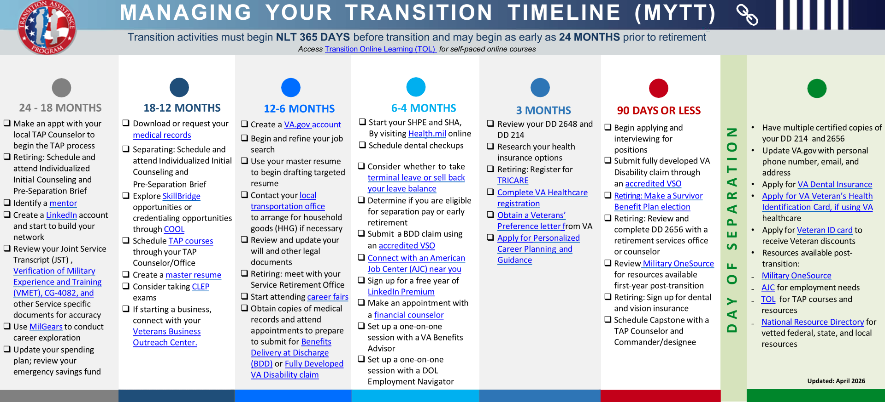
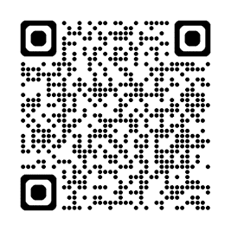

PG, p. 9

Slide 13


    Purpose and Identity
MANAGING YOUR TRANSITION
    Identifying Transition Concerns
COURSE OVERVIEW
    Managing Transition Stress
    Military vs. Civilian Culture
    Value of Mentors
    Available Resources
PG, p. 10

Slide 14
LOSS OF PURPOSE AND IDENTITY
AS A SERVICE MEMBER
PURPOSE
IDENTITY
Branch of Service
MOC
Rank
Support and defend the Constitution of the United States against all enemies…
TRIBE
Brothers- and sisters-in-arms
Military families
Base community
PG, p. 10

Slide 15

LOSS OF PURPOSE AND IDENTITY
PG, p. 10

Slide 16

FINDING NEW PURPOSE AND IDENTITY
Self-reflect and research to find a new purpose
Seek meaningful employment
Join veteran- and military-related groups
Find a cause where you can use your skills in your community
PG, p. 11

Slide 17


Who Am I?
ACTIVITY:
Describe who you are without mentioning your military experience or using military terminology.
AS A VETERAN ?
PURPOSE?
IDENTITY?
COMMUNITY?
PG, p. 12

Slide 18

WHAT ARE YOUR
TRANSITION CONCERNS?
PG, p. 13

Slide 19

TRANSITION CONCERNS
Review the list of common concerns in the Participant Guide, including the following:
Loss of purpose/identity
Paycheck not guaranteed
Getting/keeping the right job
Paying more taxes
Going into debt
Obtaining and paying for health care
Losing the military support system
Finding affordable housing
Were your concerns listed?
How do you feel knowing that others have some of the same concerns as you do?
What changes are you looking forward to after your transition?
PG, p. 14

Slide 20

RESILIENCY IN TRANSITION
“…The process of adapting well in
the face of change, adversity, or
significant sources of stress”
(Source: American Psychological Association)
TOP RESILIENCY TIPS:
    Be realistic
    Turn challenges into opportunities
    Learn from adversity
    Prepare for challenging situations
PG, p. 15

Slide 21

MANAGING TRANSITION STRESS
(Some) Symptoms
of Stress:
Isolation/Apathy
Irritability/Exhaustion
Headaches/Depression
Decreased communication
Changes in appetite or sleep
Increased use of alcohol or drugs
Feelings of anxiety or helplessness
How do YOU relieve stress?
PG, p. 16

Slide 22

RELIEVING STRESS
Communicate
Ask for help
Exercise
Eat well and drink water
Breathe or meditate
Fun with family/friends
BE FLEXIBLE!
PG, p. 16

Slide 23

MILITARY and CIVILIAN
CULTURE DIFFERENCES
Are there any topics missing?
What changes do you see as being the most significant? Why?
What changes will be the easiest to make?
Personal Choice
Attire
Pay
Work/Life Balance
Housing
Starting Over
Service to Country
We vs. I
Peer Interaction
Mission/Purpose
Rank/Respect
Language
PG, p. 18

Slide 24
TRANSITION MENTOR
Guide
Counselor
Teacher
Mentor
Consultant
Advisor
Coach
Instructor
PG, p. 21

Slide 25



MENTOR CHARACTERISTICS
Assist in setting goals
Available as a resource and sounding board
Give constructive feedback
Supportive and encouraging
Successful and respected in their fields
PG, p. 21

Slide 26
FINDING A MENTOR
Military network
Social media (i.e., LinkedIn)
Military and Veteran Service Organizations (MSO/VSO)
Online mentorship networks
Professional networking events
PG, p. 21

Slide 27






PRE-TRANSITION RESOURCES
PG, p. 22

Slide 28

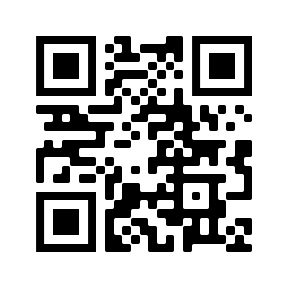

TOL: Transition Online Learning
For online TAP courses, visit TAPevents.mil/courses or scan the QR code
PG, p. 22

Slide 29
INSTALLATION RESOURCES
This slide is included for sites to add site-specific
information about Installation Resources and upcoming classes/briefings.
See font and color details below.
---------HIDE or DELETE slide if not used.---------
Title Font: Franklin Gothic Medium, All CAPS. | Body Font: Calibri Body | Size: 18+
Color Codes: Dark Blue - RGB (R: 30, G: 61, B: 88) | Light Blue - RBG (R: 0, G: 176, B: 240)

Slide 30





POST-TRANSITION RESOURCES
PG, p. 24

Slide 31

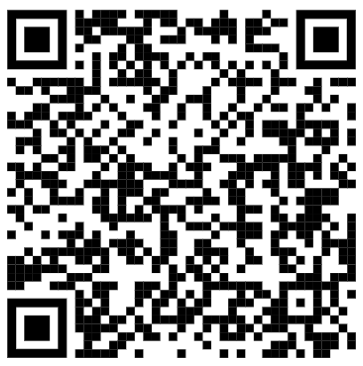
TAP Interagency website Guide
If you have not yet downloaded the Website Guide, follow the instructions below:
Use the QR code on the right or the URL below to go to: https://www.tapevents.mil/Assets/ResourceContent/TAP/TAP_Interagency_Website_Guide.pdf
Download and save the Website Guide on your computer or email it to yourself if using a government computer
PG, p. 26

Slide 32

QUESTIONS?
Reminder:
We are here to help YOU! If you have any questions at any point during your transition, please let us know.

Slide 33


We want your feedback!
Your feedback is anonymous and very valuable to the success of TAP. Every comment is read and addressed as appropriate.
TRANSITION
ASSISTANCE PARTICIPANT ASSESSMENT
Use computer or mobile device
Go to: https://www.dodsurveys.mil/tap
Select Managing Your (MY) Transition
Complete assessment
OR…SCAN THIS QR CODE WITH YOUR PERSONAL DEVICE TO BEGIN THE ASSESSMENT
PG, p. 27

