Slide 1

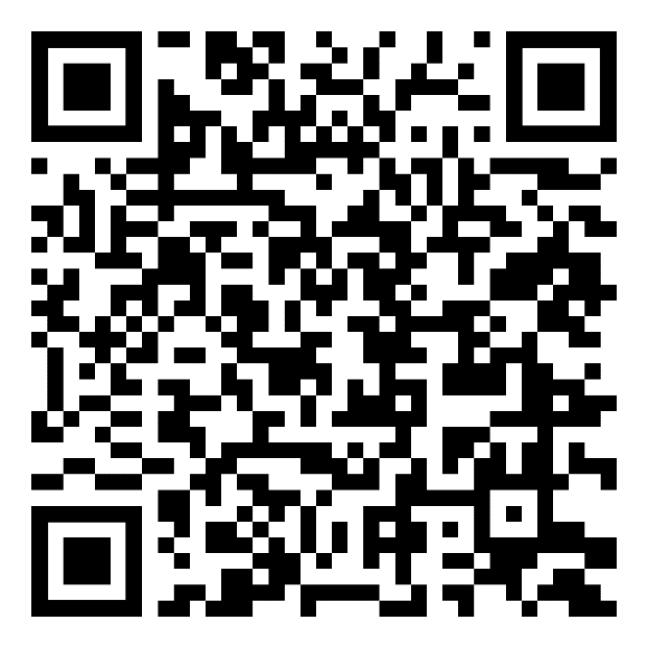

Financial planning for transition
downloads
Use the URLs below or the QR codes to go to:
  Participant Guide:
https://tapevents.mil/Assets/ResourceContent/TAP/Financial_Planning_Transition.pdf
  Spending Plan:
  https://tapevents.mil/Assets/ResourceContent/TAP/Spending_Plan_WkBk.xlsx
Download and save the documents on your computer or email them to yourself if using a government computer.
Participant Guide
Spending
plan
NOTE: The corresponding page of the Participant Guide (PG) will appear in the left, bottom corner of each slide.
PG, p. 1

Slide 2



Slide 3

DISCLAIMER
The information provided herein does not constitute a formal endorsement of any company, its products, or services by the U.S. Department of War (DoW). Specifically, the appearance or use of external hyperlinks does not constitute endorsement by the DoW of the linked websites or the information, products, or services contained therein. The DoW does not exercise any editorial control over the information you may find at these locations. While this information provides informational resource material to assist military personnel and their families in identifying or exploring resources and options, the resources provided are not exhaustive.
All websites and URLs in this guide were active at the date of publication. However, web content is subject to change without notice. Users of this guide are advised to confirm information is current.
PG, p. 3

Slide 4
TRANSITION OVERVIEW
Individualized Initial Counseling (IC)
Pre-Separation Brief
Managing Your (MY) Transition
NLT 365 Days
Begin TAP Courses
You are here
DOL Employment Fundamentals of Career Transition
VA Benefits and Services
Financial Planning for Transition
MOC Crosswalk
TRANSITION OVERVIEW
2-Day Tracks
Continuum of Service
Capstone
Employment
Vocational
Education
Entrepreneurship
NLT 90 Days
PG, p. 4

Slide 5

FINANCIAL PLANNING FOR TRANSITION
INCOME
ASSETS
Resources
FINANCIAL PLAN
Resources
DEBT & CREDIT
EXPENSES
PG, p. 5

Slide 6







WHY A SPENDING PLAN?
What will change in your transition?
EXPENSES
INCOME
RETIREMENT
SAVING
DEBT
PG, p. 5

Slide 7

INCOME
LEARNING OBJECTIVES:
Evaluate current military income and compensation.
Compare military income and compensation to projected civilian salary equivalent.
Examine the difference in tax liability between current military compensation and projected civilian salary.
INCOME
ASSETS
Resources
FINANCIAL PLAN
Resources
DEBT & CREDIT
EXPENSES
PG, p. 6

Slide 8




ACTIVITY– Access Your LES
CG Payslip:
Use your Service website or the QR code to access your LES or Payslip.
MyPay DFAS:
https://dcms.uscg.mil
https://mypay.dfas.mil/#/
PG, p. 6

Slide 9

INCOME DEFINITIONS
Total pay + allowances =
Gross Income
Gross Income –deductions and allotments =
Net Pay
Net Pay is the money you take home from each paycheck
PG, p. 7

Slide 10

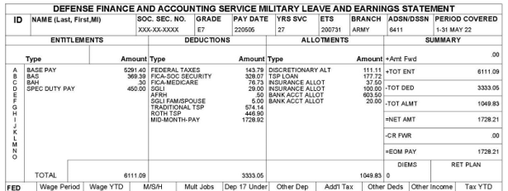
LEAVE AND EARNING STATEMENT (LES)
PG, p. 7

Slide 11
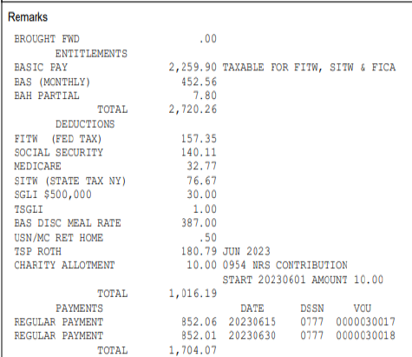
Marine Corps LEAVE AND
EARNING
STATEMENT
(LES)
PG, p. 7

Slide 12
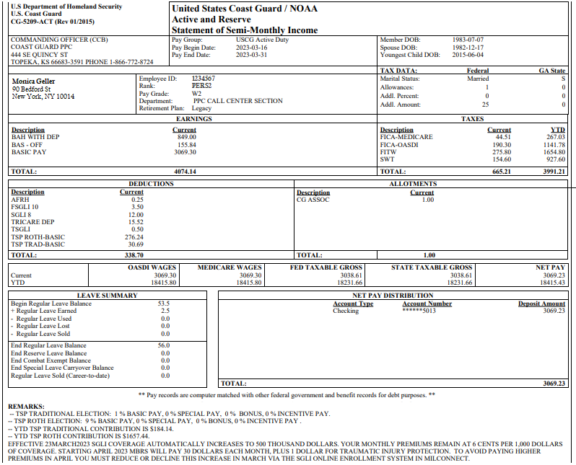

USCG
PAYSLIP
PG, p. 8

Slide 13


SPENDING PLAN UPDATE –
INCOME
Income from LES or Payslip to include all entitlements
Spouse income
Income from additional sources
Taxes, deductions, and allotments
PG, p. 9

Slide 14
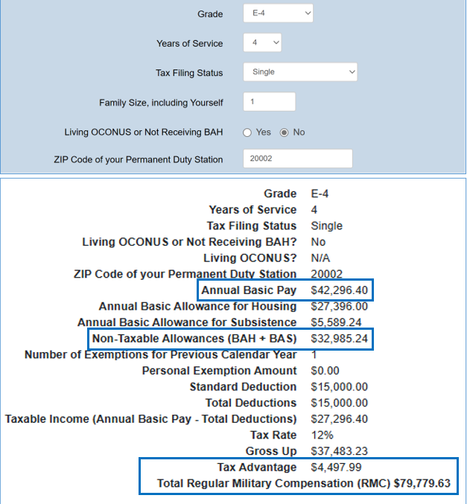
CIVILIAN
SALARY
EQUIVALENT
SEPARATING:
E-4
4 years of service
Single
Washington D.C.; 20002
Current Salary:
$42,296
$75,281 with BAH, BAS
Civilian Equivalent:
$ 79,779
PG, p. 10

Slide 15
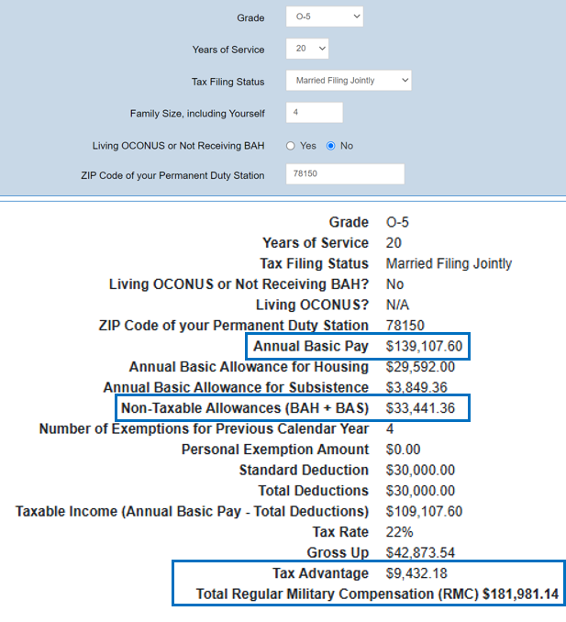
CIVILIAN
SALARY
EQUIVALENT
RETIRING:
O-5
20 years of Service
Married
Two Children
San Antonio TX; 78150
Current Salary:
$139,107
$172,548 with BAH, BAS
Civilian Equivalent:
$181, 981
PG, p. 11

Slide 16

ACTIVITY–
Civilian Salary Equivalent
Regular Military Compensation Calculator (RMC)
Go to the RMC Calculator link below or use the QR code
Provide the information requested on the RMC Calculator.
Click Calculate
On the Spending Plan add the total to the ANNUAL SALARY EQUIVALENT box under the appropriate PROJECTED column. Your MONTHLY SALARY will be calculated automatically.
Add any additional sources of income to the spending plan for a full monthly income amount.
https://militarypay.defense.gov/Calculators/RMC-Calculator/
PG, p. 12

Slide 17

Civilian Salary equivalent:
What is missing?
Special pays and incentives
Social Security
Medicare
State and local taxes
Life and lifestyle benefits
PG, p. 13

Slide 18


Total Compensation and Benefits
Military Comp/Benefits:
Health insurance (i.e., TRICARE)
Dental insurance
Vision insurance
Servicemembers’ Group Life Insurance (SGLI)
Family Servicemembers’ Group Life Insurance (FSGLI)
Death benefits
Commissary privileges
Base gym access
Base childcare facilities, etc.
Civilian Sector:
Bonus
Commissions
Paid time off
Profit sharing
Medical insurance
Stock options
PG, p. 14

Slide 19
Cost of Benefits:
Mil and CIV Comparison
BENEFIT | Military Cost | Civilian Cost*
Healthcare Premium | $0 with TRICARE | Single: $450 Family of 4: $1,450
Childcare | Per child/month: $200 - $1000 | Per child/month: $1,200
Dental insurance | Family/per month: $30 | Individual: $20-50 Family: $50-150
Vision insurance | $0 | Per person/per month: $14
Gym Membership | $0 | $40-70 per month
Family Life Insurance | $100,000 in coverage and based on age/month: $5-30 | $100,000 in coverage and based on age/month: $7-36
Total | $235 - 1,037 | $1,758-2,907
*Calculated monthly and using national average, cost varies based on location.
PG, p. 15

Slide 20


Retirement Pay
Must complete the DD 2656, along with Service requirements.
Amount can be estimated for income projections after retirement.
Calculated amount may have the following deductions:
  Federal, state, local taxes (based on state taxing of retirement pay)
  Survivor Benefit Plan
  Health/Life insurance
PG, p. 17

Slide 21
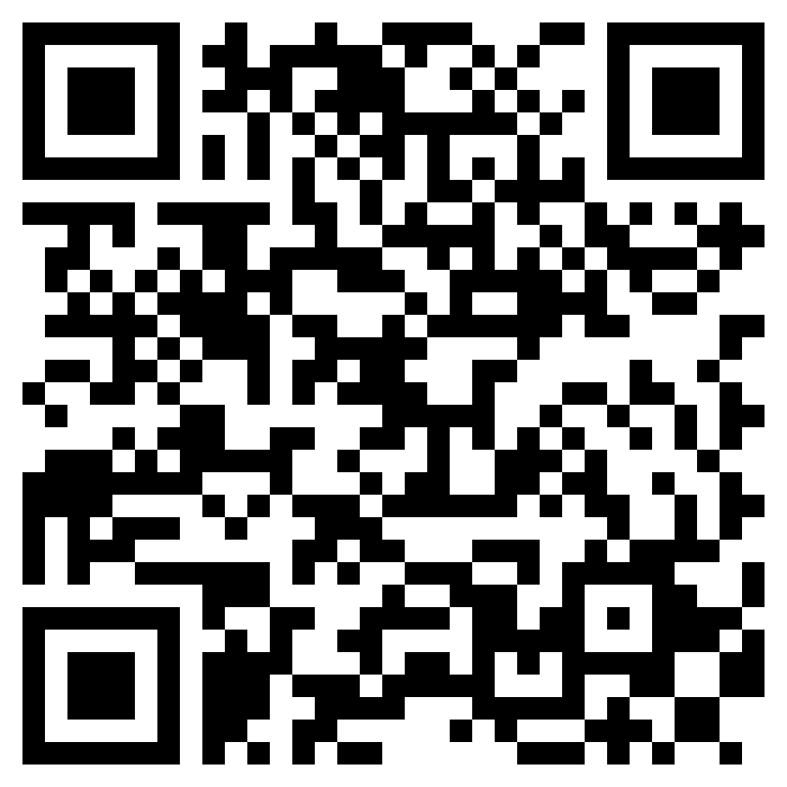
https://militarypay.defense.gov/Calculators/
ACTIVITY–
Estimate Retirement Pay
Military Pay – Projected Retirement Calculator
Use the Military Pay – Projected Retirement calculators or QR code.
Follow the directions on the website
To find yearly amount, roll over the first full High-3 Pension bar.
Divide by 12 to determine monthly pension.
Write your projected retirement pay under the “Projected” column on the spending plan.
https://militarypay.defense.gov/Calculators/
PG, p. 18

Slide 22
RETIREMENT PAY GAP
Civilian Salary Equivalent
Civilian Salary Equivalent
— Disability Pay*
— Retirement Pay
Retiree Pay Gap
Disability Pay*
Retiree Pay Gap
Retirement Pay
*If applicable
PG, p. 19

Slide 23
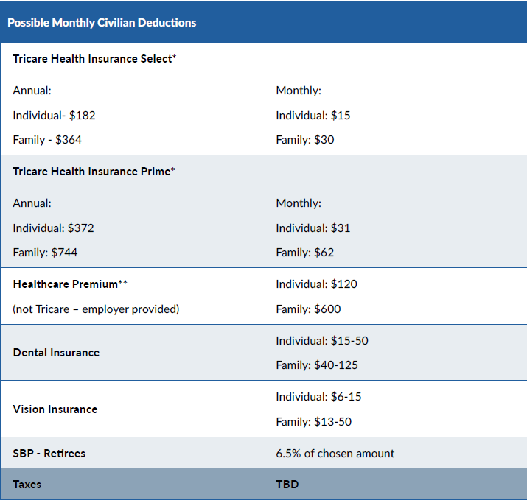
RETIREMENT PAY DEDUCTIONS
PG, p. 20

Slide 24
TAXES : Military vs. Civilian Income
S
Sample Income: $68,000
TOTAL TAXABLE INCOME
Total shown reflects take-home
NON-TAXABLE INCOME
(BAS, BAH, etc.)
FEDERAL TAXES
Example is for taxes in Virginia and includes both federal and state taxes.
PG, p. 21

Slide 25

TAXES
Taxable Income
Federal Taxes
State Income Tax
  County or City Tax
  Property Taxes
PG, p. 22

Slide 26

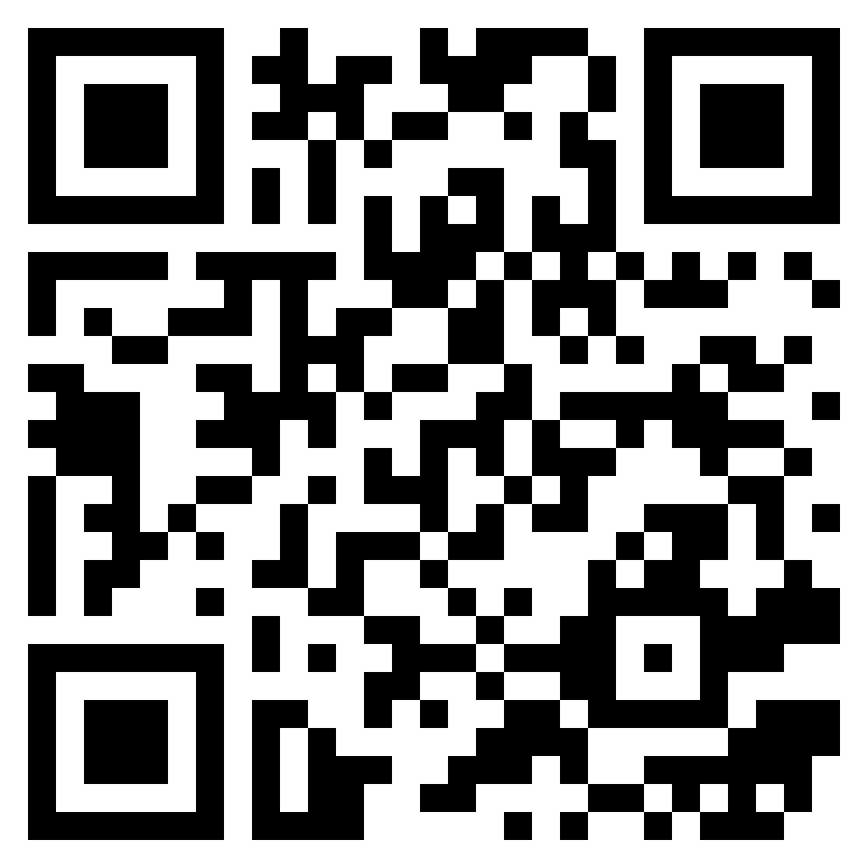
ESTIMATE YOUR TAXES
Separating
Retiring
https://smartasset.com/taxes/paycheck-calculator
Enter the following information:
  Total salary equivalent
  Choose Salary, marital status, zip code, # of dependents and monthly.
  Scroll to find the gross paycheck, taxes, and take-home salary.
  Add total taxes to the
    spending plan.
www.smartasset.com/retirement/retirement-taxes
Choose the state you wish to retire in
Complete the following information:
  SS = $0 (if not drawing SS)
  Annual wages = amount needed to close the gap between retirement pay and civilian salary equivalent
  Location = zip code
  Year of birth
  Filing Status
  Click Add Pension
  Add Military Retired Pay to Public
    Pension
PG, p. 24
PG, p. 26

Slide 27

INCREASE INCOME
Increase Income
Spouse finds employment Active-duty person finds a part-time job Sell items you no longer use | Review and change tax filing status and other withholding inputs Add side hustle – uber, online, etc. | Seek out temporary or seasonal work Apply for unemployment entitlement after transition
PG, p. 27
Notes:
Look better?

Slide 28
INCOME REVIEW
Time for review
Civilian Equivalent Salary?
Changes to taxes?
Non-taxable income?
Website for help?
PG, p. 28

Slide 29
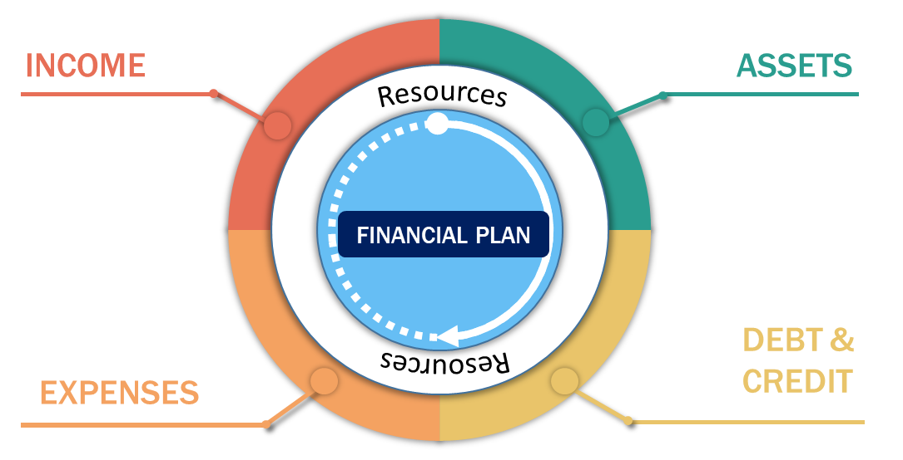

EXPENSES
LEARNING OBJECTIVES:
  Create or update a list of current expenses
  Compare cost of living at current and 2nd location
  Describe the basics of health insurance
PG, p. 29

Slide 30

LIVING EXPENSES
PG, p. 29
Notes:
ANIMATED SLIDE

Slide 31


SPENDING PLAN UPDATE – ESTIMATE EXPENSES
  Rent or Mortgage payment
  Household
  Transportation
  Food (Groceries/Dining Out)
  Healthcare
  Personal and Family
  Leisure
PG, p. 30

Slide 32

TRACK SPENDING
Record all expenses daily or weekly using receipts
Use a paper/pen, spreadsheet, notebook,
Use a free and secure app (be sure to protect personal information)
Review past credit card or bank statements
Be sure to track ALL purchases!
PG, p. 30

Slide 33
DECREASE EXPENSES
Ways to Decrease Expenses
Down grade or eliminate cable or streaming packages Bundle packages for cable, Internet, and cell phone Shop around for auto, home, and life insurance Use coupon/discounts for shopping, dining out, and recreational activities | Review current cell phone plan to determine if any extras can be removed Use public transportation or carpool Shop at thrift stores Ask utility companies about a budget plan for consistent utility bills | Ask for veteran and military discounts Find friends who can trade services (e.g., babysitting, pet sitting, etc.) Cook at home and pack your lunch, plan menus around foods on sale
PG, p. 31

Slide 34


COST OF RELOCATION
Can relocation impact your financial plan?
COST-OF-LIVING CHANGES
  Salary
  Housing
  Utilities
  Taxes
  Food
  Childcare
  Commuting costs
  Clothing
  Entertainment
  School costs
  Climate
  Health insurance
PG, p. 31

Slide 35
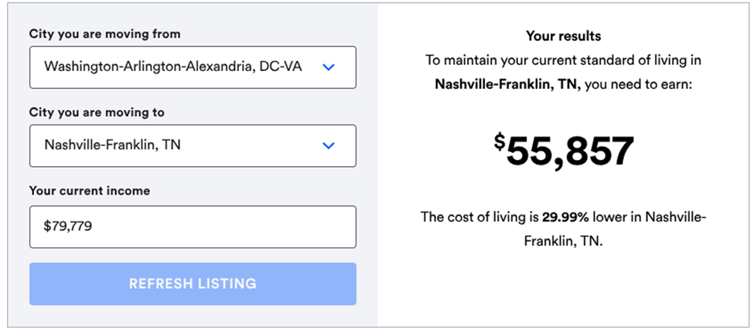
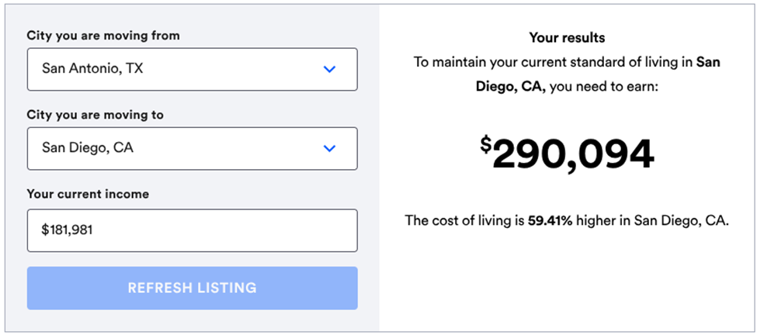
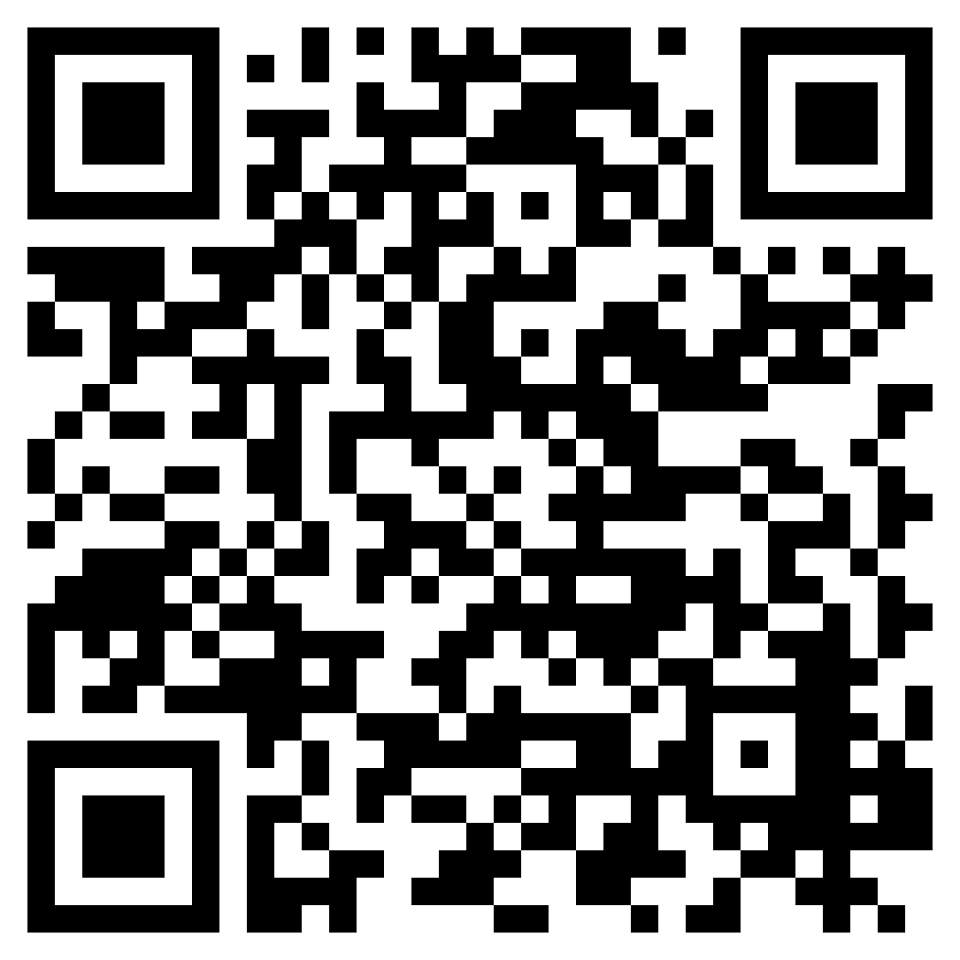
COST-OF-LIVING CALCULATOR
Bank Rate COL Calculator:
https://www.bankrate.com/calculators/savings/moving-cost-of-living
PG, p. 32

Slide 36


HEALTHCARE and TRANSITION
Be prepared, know your options, and make informed decisions!
Prior to Transition:
Healthcare provided with little to no cost
Medications/prescriptions provided at little or no cost
Dental and vision were covered with minimal cost
After Transition:
Will need to purchase health insurance to include dental and vision
Expect out of pocket expenses related to healthcare
More options with different costs
PG, p. 35

Slide 37


HEALTH CARE
CHOICES AFTER TRANSITION
Retiring from Active Duty
Tricare for Military Retirees
  Sign up for TRICARE
  Pay the annual premium
  Choose between Tricare Prime or Select
  Ensure the nearest MTF is accepting retirees
  Find vision and dental insurance; Tricare for Retirees
  does NOT include either
?
National Guard/Reserves:
Eligible for Reserve Select, Retired Reserves, CHCBP, TAMP
PG, p. 35

Slide 38


HEALTH CARE
CHOICES AFTER
TRANSITION
Separating from Active Duty
Transitional Assistance Management Program (TAMP)
  Eligibility requirements must be met
  180 days, premium-free
Continued Health Care Benefit Program (CHCBP)
  Up to 18 months – can be used after TAMP expires
  Quarterly premiums to be paid
  Enrollees responsible for co-pay and deductible
National Guard/Reserves:
Eligible for Reserve Select, Retired Reserves, CHCBP, TAMP
PG, p. 35

Slide 39

CIVILIAN HEALTH INSURANCE OPTIONS
EMPLOYER or GROUP:
Part of a group benefit plan
Less expensive than individual
Limited choices on coverage
May have a monthly cost associated
Cost deducted from paycheck
MARKETPLACE or INDIVIDUAL:
Directly from insurance company
May need to meet eligibility requirements (needs and income)
May be more expensive, but more choices
Possibility of being denied
PG, p. 37

Slide 40

HEALTHCARE TERMS
Premium Annual Deductible Cost Sharing or Co-Insurance Co-payment In-Network Cost Out-of-Network Cost | Out-of-Pocket Cost Catastrophic Cap or Out-of-Pocket Maximum Flexible Spending Account (FSA) Health Savings Account (HSA) Qualifying Life Event (QLE)
PG, p. 37

Slide 41

TYPES OF PLANS
Preferred Provider Organizations (PPO)
Point of Service (POS)
Exclusive Provider Organization (EPO)
Health Maintenance Organizations (HMO)
Catastrophic Plan
Which plan is right for you and your family?
PG, p. 39

Slide 42


CONSIDERATIONS WHEN CHOOSING A PLAN
Estimate yearly medical needs
Compare plans and costs
Consider a FSA
Review prescription coverage
What do you and your family need in a healthcare plan?
PG, p. 39

Slide 43



DENTAL and VISION INSURANCE
SEPARATEES:
Provided through an employer
Directly from insurance provider, such as:
  VA Dental Insurance Program (if enrolled in VA healthcare)
  Healthcare marketplace
RETIREES:
TRICARE does NOT include dental and vision coverage
Provided through an employer
Directly from insurance provider, such as:
  Federal Employees Dental and Vision Insurance Program (FEDVIP)
  Healthcare marketplace
FEDVIP
PG, p. 41
Notes:
Pictures? Better arrangement?

Slide 44

COST of HEALTH INSURANCE
National Average Cost of Healthcare in 2023
$14,570 per person, annually
Initial visit - $100 – 200
  Specialist - $250
(National Health Expenditure Accounts Data, CMS.gov)
Healthcare costs can be estimated by using the Marketplace (https://www.healthcare.gov/see-plans/#/)
Provides the estimate of individual/Marketplace, not the cost through an employer
PG, p. 42

Slide 45

DISABILITY INSURANCE
Provides full or partial income should you become too sick or injured to work
  May be a benefit provided by your employer or purchased from insurance company
PG, p. 42

Slide 46
EXPENSES REVIEW
Tracking expenses before transition?
Time for review
Health insurance?
Dental and vision insurance?
PG, p. 43

Slide 47
DEBT and CREDIT
LEARNING OBJECTIVES:
  Understand debt and credit
  Analyze the impact of credit on your transition
  Identify ways to decrease debt prior to transition
INCOME
ASSETS
Resources
FINANCIAL PLAN
Resources
DEBT & CREDIT
EXPENSES
PG, p. 44

Slide 48

WHAT IS YOUR DEBT?
Debt: an amount that is owed to another individual or bank
Calculate your debt: determine to whom you own money and the minimum payment due each month, along with the interest rate
PG, p. 44

Slide 49

SPENDING PLAN
UPDATE – DEBT
Mortgage or Home Loan
Car Loans
Credit Cards
  Bank, department stores, Military Star Card, etc.
Loans
  Personal, student, consolidated loans, etc.
Advance payments
Military organizations, family, friends
PG, p. 45

Slide 50
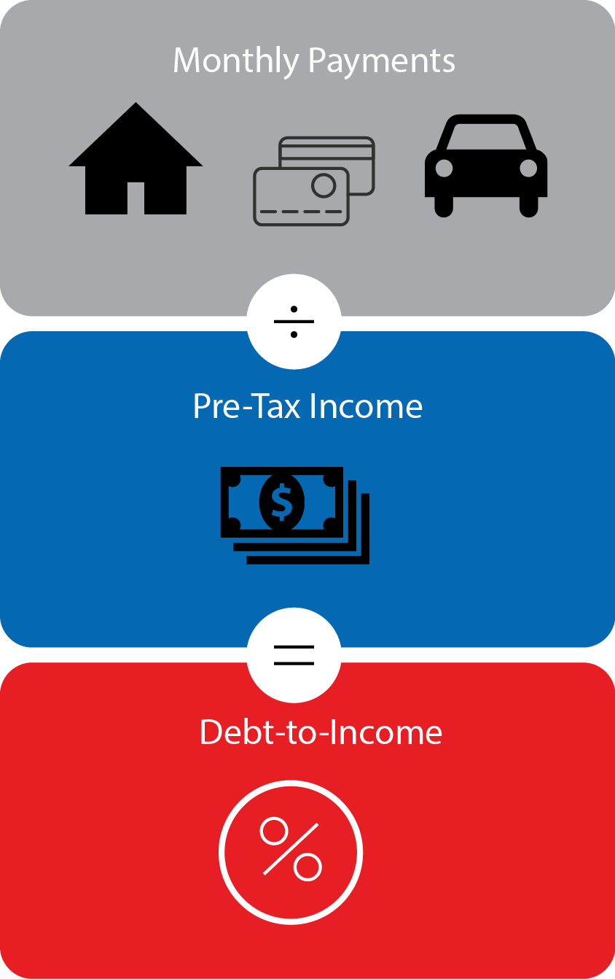
DEBT-TO-INCOME RATIO
Total MINIMUM monthly payments
$2,050
÷
Gross monthly income (pre-taxes)
$5,308
=
The debt-to-income ratio calculation:
2050 ÷ 5308 = 0.38
0.38 x 100 = 38
DTI: 38%
PG, p. 45

Slide 51

DECREASE DEBT
Decrease Debt:
Pay more than the minimum payment. Pay down debt using a power pay plan. Refinance debt. | Use any raise or windfall to pay down a debt. Enroll in a non-profit debt management program. | Negotiate to settle for less than what you owe. Seek assistance from your installation or TAP financial counselor.
PG, p. 46

Slide 52




ACTIVITY–
Access Credit Report
AnnualCreditReport.com
Reviewing your credit report during this section will provide you with a better understanding of the content.
Each Credit Bureau provides a free report each week. You may be required to create an account.
TransUnion: TransUnion.com
Experian: Experian.com
Equifax: Equifax.com
Choose one of the three credit bureaus.
Follow the prompts (if you are asked for a credit card you are on the wrong site).
Access your Credit Report.
PG, p. 48
DO NOT SHARE YOUR REPORT!!!

Slide 53

REVIEWING YOUR CREDIT REPORT
Review Personal Information
What to check
01
All open accounts are yours
02
Inquires from credit you applied for
03
Account history listed for
your accounts
04
Negative information
05
All debts discharged in bankruptcy are listed that way
06
PG, p. 49

Slide 54


CORRECTING A REPORT
1
Use online credit report dispute process provided by each of the credit agencies:
  TransUnion
  Experian
  Equifax
2
Visit your installation PFM to assist and discover the best option.
3
Consumer Financial Protection Bureau (CFPB) can also assist in resolving errors: www.consumerfinance.gov
PG, p. 50

Slide 55
CREDIT SCORES
What is a Credit Score?
Three-digit number generated by a mathematical algorithm based on information in your credit report
FICO – Most common
FICO Range : 300 - 850
PG, p. 51

Slide 56


FICO SCORE FACTORS
Source: myfico.com
PG, p. 51

Slide 57

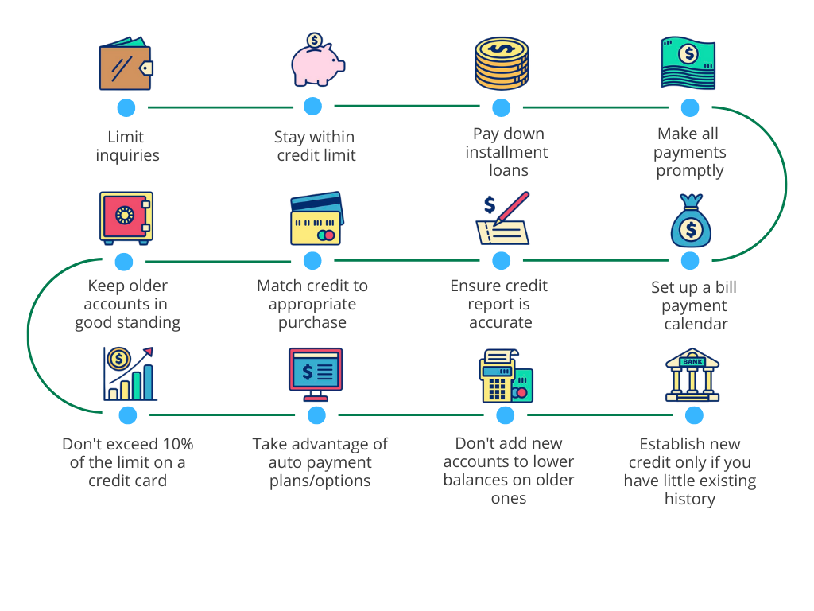
WAYS TO IMPROVE YOUR CREDIT SCORE
Limit Inquiries
Stay within Credit Limit
Pay Down Installment Loans
Prompt Payments
$
Accounts in Good Standing
Match credit to purchase
Ensure Credit Report is accurate
Set up Auto Bill Pay
Don’t exceed 10% credit card use
Use Auto Pay options for loans
Don’t add new accounts to lower balances
Apply for new credit wisely
PG, p. 53

Slide 58

CREDIT AND YOUR TRANSITION
GOVERNMENT
AGENCIES
INSURANCE
COMPANIES
CREDITORS
EMPLOYERS
LANDLORDS
PG, p. 53

Slide 59
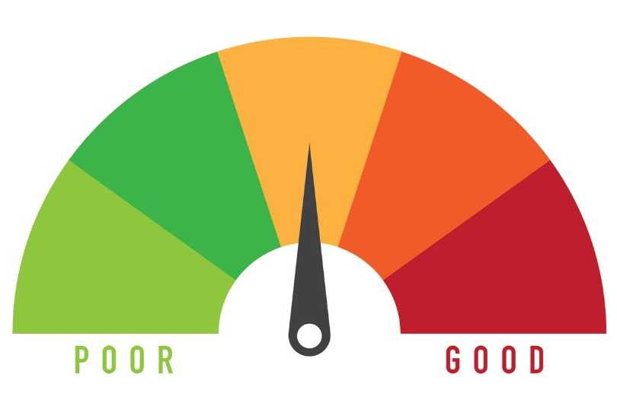


CREDIT REPAIR/DEBT RELIEF
CREDIT REPAIR
DEBT RELIEF
Exercise great caution if using credit repair agency or debt relief companies
PG, p. 54

Slide 60
FINANCIAL WELL-BEING FACTORS
Level of Debt
Based on the past performance with credit, ability to pay bills on time, and current debt situation
How much of current income is utilized for monthly expenses and payments
Credit Score
FINANCIAL
WELL-BEING
PG, p. 55

Slide 61
DEBT & CREDIT REVIEW
Time for review
Reduce debt?
Access credit report? Why?
Improve credit score?
PG, p. 56

Slide 62
ASSETS
LEARNING OBJECTIVES:
Define assets
Calculate net worth
Illustrate the difference between a defined benefit plan and a defined contribution plan
Analyze options available for TSP when transitioning
Recognize the reasons a savings account is essential during transition
Understand available life insurance options
INCOME
ASSETS
Resources
FINANCIAL PLAN
Resources
DEBT & CREDIT
EXPENSES
PG, p. 57

Slide 63

WHAT IS AN ASSET?
Items of ownership convertible into cash.
  Personal Property
  Savings
  Investments
  Retirement Pensions
  Life Insurance
PG, p. 57

Slide 64


PERSONAL PROPERTY
Home
Car
Jewelry
Electronics
Collectibles
  Savings = 2 weeks of expenses or $1,000
  Emergency Savings = 3-6 months of financial obligations
  Goal Savings = funds for a specific goal or item
SAVINGS
PG, p. 57

Slide 65

THRIFT SAVINGS PLAN (TSP) OPTIONS
Stay: if you have at least $200 in your TSP account, you can continue to participate but not contribute.
Rollover: you can transfer your funds from the TSP to an IRA, Federal Civilian TSP, or another eligible employer retirement plan.
Distribution: withdraw your funds as cash from TSP; may incur withdrawal or distribution penalties and taxes.
Contact TSP:
1-877-968-3778
www.tsp.gov
Some funds may include tax-exempt contributions.
PG, p. 58

Slide 66
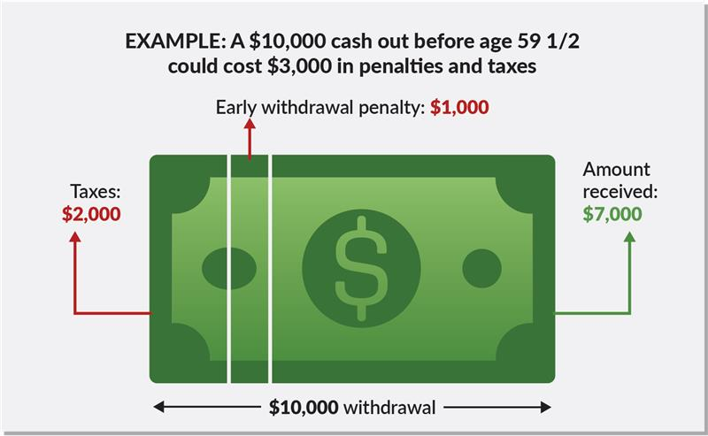
EARLY TSP DISTRIBUTION
DISCLAIMER: This is only an EXAMPLE; actual numbers will vary based on federal, state, and local taxes.
PG, p. 59

Slide 67


TSP CONSIDERATIONS for TRANSITION
Update Address – ensure contact information is correct within the DFAS.
TSP Beneficiaries – beneficiaries are listed correctly and know how to access your TSP account.
Loans – loans against the TSP have 3 options:
  Set up monthly payments
  Pay off the loan
  Allow loan to be foreclosed
NGR – visit the TSP website when you change status for information on TSP
PG, p. 60

Slide 68

RETIREMENT PLANS
DEFINED–BENEFIT PLAN
DEFINED-CONTRIBUTION PLAN:
  The contribution is defined - yet the ultimate benefit to be paid is not.
  For example:
  401(k) and 403(b) plans
  TSP
  Simple IRA, Roth IRA
  SEP
  Employee Stock Ownership (ESOP)
  Traditional company pension plan – ultimate retirement benefit is definite and determinable as a dollar amount.
PG, p. 60

Slide 69


Eligibility:
Entered Service before January 1, 2018
HIGH-3 MILITARY RETIREMENT PLAN
Defined Benefit:
Calculated using 2.5% multiplied by number of years multiplied by highest 36 months of basic pay
Available only after 20 years of service
Service member may have TSP, but with NO matching
For more information visit the Military Pay website: https://militarypay.defense.gov/
PG, p. 62

Slide 70
BLENDED RETIREMENT SYSTEM (BRS)
Defined Contribution (TSP):
  Service member contributes percentage of pay into TSP
  Government contributes matching up to 5%
  Service member retains all contributions and matching after 2 years
Defined Benefit:
  Calculated using 2% multiplied by number of years, after 20 years of service
  For more information visit the BRS website: https://militarypay.defense.gov/BlendedRetirement/
PG, p. 62

Slide 71
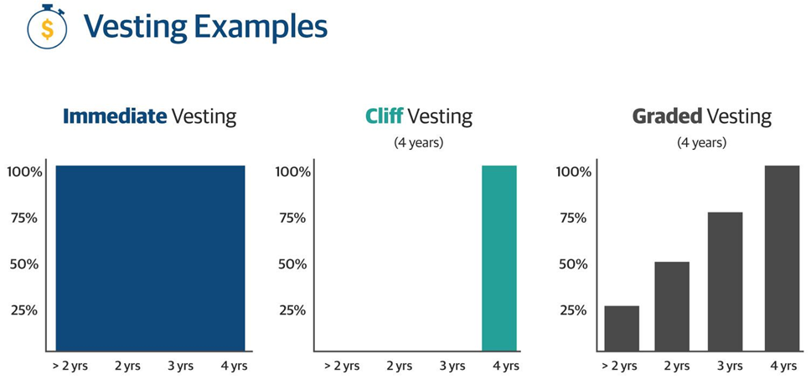
EMPLOYER RETIREMENT PLANS
Examples :
  401(k), 403(b), IRA
  Employee Stock Ownership
  TSP
Waiting/Vesting Examples
PG, p. 62

Slide 72
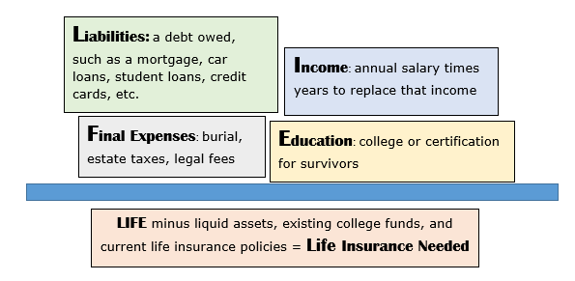
LIFE INSURANCE
How much do you need?
Note that your needs will change over time
PG, p. 63

Slide 73
LIFE INSURANCE
PLANS and OPTIONS
Options:
Veteran’s Group Life Insurance (VGLI)
Employer Life Insurance
Commercial Life Insurance
  Plans
  Term Life Insurance
  Permanent (Whole, Variable, Universal)
PG, p. 64

Slide 74

SURVIVOR BENEFIT
PLAN (SBP)
The SBP can financially protected the beneficiary in the event of the death of the retiree.
Eligible beneficiary will receive a monthly annuity for their lifetime.
Election or decline in the SBP is made prior to retirement on the DD2686.
Enrolled retirees pay SBP premiums via deductions from their pre-tax retirement compensation.
For more information visit your installation PFM or:
https://www.dfas.mil/retiredmilitary/provide/sbp.html
PG, p. 65

Slide 75

SURVIVOR BENEFIT
PLAN (SBP)
ADD INFORMATION ON THE NEXT SBP CLASS BEING OFFERED ON YOUR INSTALLATION.
IF THIS SLIDE IS NOT USED, DELETE or HIDE THE SLIDE.
PG, p. 66
Notes:
Can we change the pic?

Slide 76


YOUR NET WORTH
Assets: What You Own
Liabilities: What You Owe
PG, p. 66

Slide 77






ESTATE PLANNING
DO YOU HAVE ALL OF THIS COVERED?
SEE YOUR LOCAL LEGAL OFFICE TO GET STARTED
Establish a letter of intent
Create a will
Designate/update beneficiaries
Set up a trust
Establish guardians for dependents
Set up Durable POA for Healthcare and Finance
PG, p. 67

Slide 78
ASSETS REVIEW
Time for review
Asset, liability, net worth?
Defined-contribution and defined-benefit retirement plan?
Estate Plan?
PG, p. 68

Slide 79

FINANCIAL PLANNING FOR YOUR TRANSITION
LEARNING OBJECTIVES:
Create a plan containing next steps in the financial journey to prepare for transition
Interpret information to identify scams
Identify reliable financial resources after transition
INCOME
ASSETS
Resources
FINANCIAL PLAN
Resources
DEBT & CREDIT
EXPENSES
PG, p. 69

Slide 80

What is your current financial situation?
Review the following from your spending plan:
  Income
  Expenses
  Debt
  Assets
Consider the following:
  Do you use military-specific benefits (i.e., healthcare, childcare)?
  Have you identified where your income is being spent?
  Are you comfortable with your level of debt?
  Have you calculated all savings and assets?
  Is your credit report accurate and your score acceptable?
PG, p. 69

Slide 81


What financial changes will occur during and after transition?
Based on your post-transition plans, what financial changes do you need to consider?
  Have you calculated the income necessary to maintain your current lifestyle?
  Did you include reduced-cost benefits in your projected income needs?
  Is your savings enough to cover 3-6 months of expenses?
  What new living expenses do you have to pay?
  Will there be relocation expenses?
PG, p. 70
Notes:
Needs new pic; pic from another slide

Slide 82

Are you prepared with strategies to reduce the impact transition may have on your finances?
Create or update your spending plan
Ways to improve a financial situation, through:
  Increasing income
  Decreasing expenses
  Decreasing debt
Do you know which suggestions you can/will implement, if necessary?
You now have ability and knowledge, through the activities and websites, required to complete your spending plan.
PG, p. 70

Slide 83

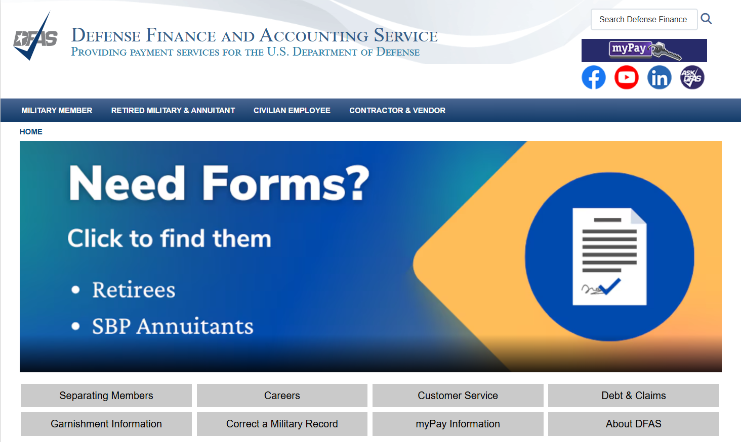
FINAL PAY
PROCESS
FINAL PAY:
Can take up to 120 days before your final paycheck is deposited.
Will be deposited on random day; similar to a special pay.
Issues: Contact DFAS – 888-332-7411
RETIREE PAY:
Complete the DD 2656 for retirement pay processing.
Can take 30-60 days after retirement date to receive first retiree check.
Issues: Contact DFAS – 800-321-1080
PG, p. 71

Slide 84

ACCESSING myPAY
TIME TO ACCESS:
Separating
  13 months only
Retiring
  13 months for statements from in service period
  New Login credentials will arrive when your retired pay account is established
TO MAINTAIN ACCESS:
Log on using a personal device to:
  Update email and physical address
  Update security questions and review personal settings
  Print/save a copy of all W2s for the last 13 months
Create a non-CAC Login to maintain access without a CAC
PG, p. 67

Slide 85
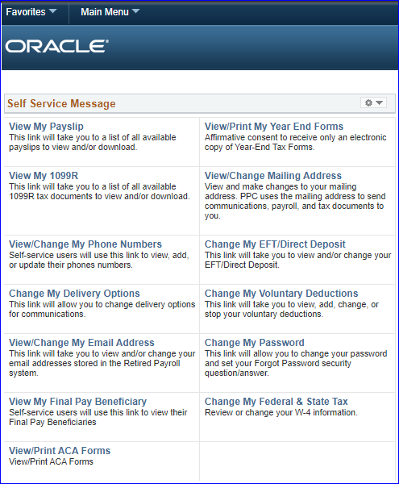


DIRECT
ACCESS
Log in through: www.dcms.uscg.mil
PG, p. 73

Slide 86


FRAUD AND SCAMS
In 2024, Americans were scammed
out of $12.5 billion* dollars.
If it seems too good to be true, it probably is!
Red Flags
Pressured to act
Guaranteed success
Promise high returns
Requires upfront investment
Requests overpayment
Common Scams
Fake military charities
Phone debt collectors
Military loan scam
Lump Sum BRS scam
DFAS/MyPay phishing scam
Insurance scam
PG, p. 73
* According to the Federal Trade Commission
This Photo by Unknown Author is licensed under CC BY

Slide 87






PRE-TRANSITION RESOURCES
PG, p. 75

Slide 88
INSTALLATION RESOURCES
This slide is included for sites to add site-specific
information about Installation Resources.
See font and color details below.
HIDE slide if not used; if deleted, slide numbers used in the Facilitator Guide will not match the slides.
Title Font: 48-54 pts - Franklin Gothic Medium, All CAPS. | Body Font: Minimum 18 pts - Calibri Body
Color Codes: Dark Blue - RGB (R: 30, G: 61, B: 88) | Light Blue - RBG (R: 0, G: 176, B: 240)

Slide 89







POST-TRANSITION RESOURCES
PG, p. 75

Slide 90
FINANCIAL PLANNING FOR YOUR TRANSITION REVIEW
Time for review
Financially ready for transition?
Final Pay?
Financial assistance?
PG, p. 76

Slide 91

FINANCIAL PLANNING for TRANSITION Summary
  CRS: Complete a transition spending plan
  Make an appointment with installation or TAP financial counselor, if necessary
  Complete the TAP Participant Assessment for Financial Planning for Transition
PG, p. 76

Slide 92
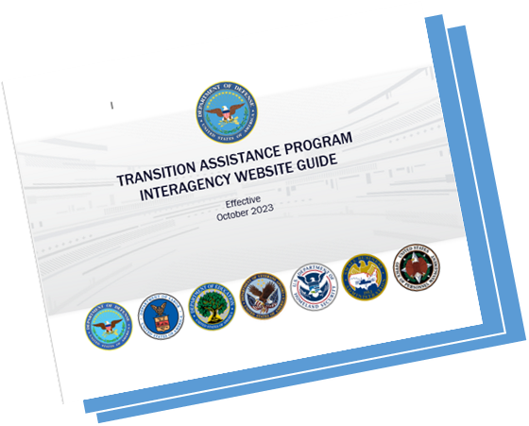
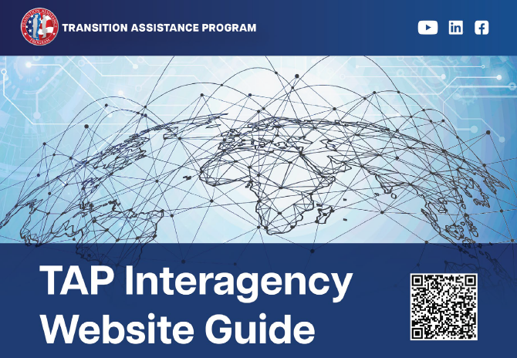
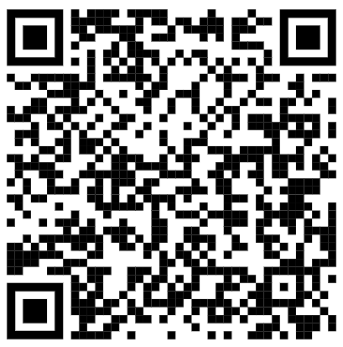



TAP Interagency
website Guide (TIWG)
If you have not yet downloaded the Website Guide, please do so now by following the instructions below:
Use the QR code on the right or the URL below to go to:
https://www.TAPevents.mil/Assets/ResourceContent/TAP/TAP_Interagency_Website_Guide.pdf
Download and save the Website Guide on your computer or email it to yourself if using a government computer
PG, p. 77

Slide 93



We want your feedback!
Your feedback is anonymous and very valuable to the success of TAP. Every comment is read and addressed as appropriate.
TRANSITION
ASSISTANCE PARTICIPANT ASSESSMENT
Use computer or mobile device
Go to: https://www.dodsurveys.mil/tap
Select Financial Planning for Transition
Complete assessment
OR…SCAN THIS QR CODE WITH YOUR PERSONAL DEVICE TO BEGIN THE ASSESSMENT
PG, p. 78

Slide 94

QUESTIONS?
Reminder:
We are here to help YOU! If you have any questions at any point during your transition, please let us know.

