Slide 1
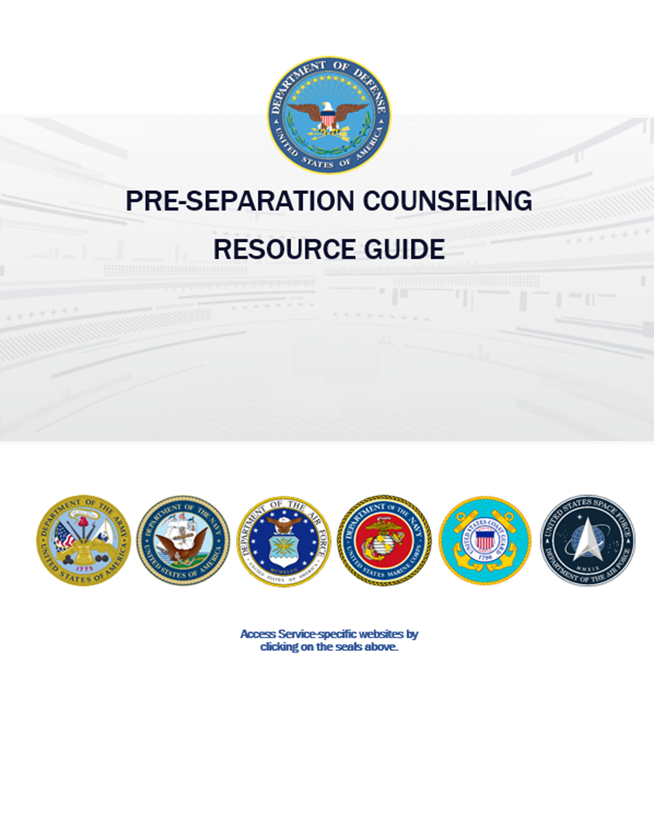
PRE-SEPARATION COUNSELING
RESOURCE GUIDE
Use the QR code on the right or the URL below to go to: https://www.tapevents.mil/Assets/ResourceContent/TAP/Pre_Separation_Counseling_Resource_Guide.pdf
Select the Pre-Separation Counseling Resource Guide.
Download and save the Resource Guide on your computer or email it to yourself if using a government computer.
NOTE: The corresponding page of the Resource Guide (RG) will appear in
the left, bottom corner of each slide in this brief.
RG, p. XX

Slide 2
October 2024
Pre-Separation
Counseling
Notes:
Add QR code for guide.

Slide 3
DISCLAIMER
The information provided herein does not constitute a formal endorsement of any company, its products, or services by the U.S. Department of Defense (DoD). Specifically, the appearance or use of external hyperlinks does not constitute endorsement by the DoD of the linked websites or the information, products, or services contained therein. The DoD does not exercise any editorial control over the information you may find at these locations. While this information provides informational resource material to assist military personnel and their families in identifying or exploring resources and options, the resources provided are not exhaustive.
All websites and URLs in this guide were active at the date of publication. However, web content is subject to change without notice. Users of this guide are advised to confirm information is current.
RG, p. 3

Slide 5
10 STEPS TO TRANSITION
STEP 1: Plan for Your Transition
STEP 2: Build Your Transition Team
STEP 3: Know Your VA Benefits
STEP 4: Plan for Health/Mental Care and Health Insurance
STEP 5: Plan for Civilian Employment/Vocational Training
STEP 6: Learn About Federal Employment
STEP 7: Plan for Further Education
STEP 8: Consider Starting a Business
STEP 9: Explore Additional Information and Benefits
STEP 10: Know Where to Go for Assistance
RG, p. 4
Notes:
Remind the SM the number in the corner of the slide is the page number in the Pre-Sep Resource Guide.

Slide 6
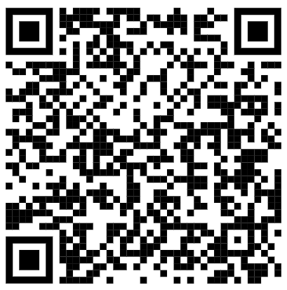
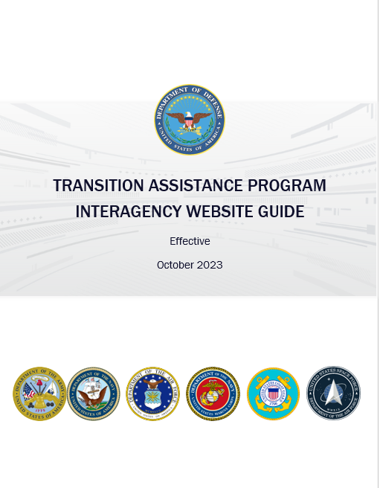
The TAP Interagency
website Guide
Use the QR code on the right or the URL below to go to: https://www.tapevents.mil/Assets/ResourceContent/TAP/TAP_Interagency_Website_Guide.pdf
Download and save the Website Guide on your computer or email it to yourself if using a government computer
RG, p. 5
Notes:
To access Pre-Separation Resource Guide:
http://www.tapevents.mil/Resources

Slide 7
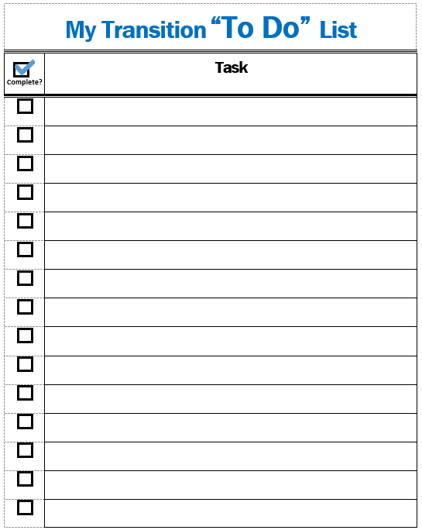
MY TRANSITION “TO DO” LIST AND NOTES PAGE
ACTIVITY
Throughout this brief, add the tasks you need to complete and take notes as you prepare for transition.
RG, p. 5

Slide 8
STEP 1:
Plan for Your Transition
STEP 2: Build Your Transition Team
STEP 3: Know Your VA Benefits
STEP 4: Plan for Health/Mental Care and Health Insurance
STEP 5: Plan for Civilian Employment/Vocational Training
STEP 6: Learn About Federal Employment
STEP 7: Plan for Further Education
STEP 8: Consider Starting a Business
STEP 9: Explore Additional Information and Benefits
STEP 10: Know Where to Go for Assistance
RG, p. 6
Notes:
Ask the following question: What are some changes you expect to experience during transition?

Slide 9
TRANSITION ASSISTANCE PROGRAM (TAP)
Congressionally mandated program that provides information, tools, and training to ensure Service members and their spouses are prepared for the next step in civilian life.
Title 10 U.S.C., Sections 1142, 1143, 1144
NDAA FY 19 John S. McCain, Section 552—Improvements to TAP
NDAA FY20, Sections 570c, 570f
DoDI 1332.35—TAP for Military Personnel
RG, p. 6
Notes:
TAP (not TAPS) is a congressionally-mandated program enacted in 2011 that provides information, tools, and training to ensure service members and their spouses are prepared for the next step in civilian life.

Slide 10
TAP OVERVIEW
You are here
Individualized Initial Counseling (IC)
Pre-Separation Counseling
Managing Your (MY) Transition
NLT 365 days
DoD Transition Day
DOL Employment Fundamentals of Career Transition
VA Benefits and Services
Financial Planning for Transition
MOC Crosswalk
2-Day Tracks
Continuum of Service
Capstone
Employment
Vocational
Education
Entrepreneurship
NLT 90 Days
RG, p. 7

Slide 11
CAREER
READINESS
STANDARDS
Individualized Initial Counseling
Deliverables assigned
CRS
Ensure you are ready for transition.
TAP Courses
Deliverables initiated
Capstone
Deliverables verified
RG, p. 7

Slide 12
GETTING STARTED
INDIVIDUALIZED INITIAL COUNSELING
CRS
Complete a personal self-assessment
Initiate an Individualized Transition Plan (ITP)
PRE-SEPARATION COUNSELING
RG, p. 7
Notes:
Prior to this session (Pre-Separation Counseling), participants should have completed their Individualized Initial Counseling (IC) NLT.
The IC was a face-to-face discussion about transition with a member of the unit’s chain of command, a transition counselor, or a career counselor during which the following occurred:
1. Completed a personal self-assessment (CRS)
2. Began development of the Individual Transition Plan (ITP)
3. Initiated the DD eForm 2648
4. Determined Tier and Career Readiness Standard (CRS) requirements
• Current step—Pre-Separation/Transition Counseling (MANDATORY)—legislatively-mandated information about various services, benefits, and resources available during and after transition.
POLL: Ask for a show of hands to confirm participants have completed:
1) Individualized Initial Counseling
2) Self-Assessment
3) Initiated an ITP (provided by the services)
4) Know their Tier.
• Instruct the service members who have not completed IC, self-assessment or ITP to see their transition counselor immediately following this brief.

Slide 13
INDIVIDUAL INITIAL COUNSELING
Notes:
Each service has its own ITP. Add service-specific ITP information or transition checklist here by following the instructions on the slide.
• The ITP is initiated during IC.
• A completed ITP is one of CRS for transition and is a personalized plan of goals, actions, and milestones.

Slide 14
DD FORM 2648
Service Member Pre-Separation/Transition Counseling and Career Readiness Standards eForm for Service Members Separating, Retiring, Released from Active Duty (REFRAD)
DD eFORM 2648 tracks completion of all TAP requirements.
Initial Counseling: Initiated
Pre-Separation Counseling: e-Sign
Capstone: e-Sign
Filed in official military record
Save copy for your records
RG, p. 8
Notes:
Transition/Career Counselor initiates the DD Form 2648 at IC and is used to track the completion of TAP requirements.
• Service member signs electronically after completing Pre-Separation Counseling and again after Capstone.
• Final copy becomes part of the service members’ military records.
• Service members are encouraged to save an electronic and/or hard copy for their records.

Slide 15
TAP CORE CURRICULUM:
DoD/DHS Transition Day
MANAGING YOUR (MY) TRANSITION
MOC CROSSWALK
CRS
Complete a Gap Analysis or provide verification of employment
FINANCIAL PLANNING FOR TRANSITION
CRS
Prepare a criterion-based, post-separation financial plan
RG, p. 8
RG, p. X

Slide 16
TAP CORE CURRICULUM:
VA Benefits and Services
CRS
Register on VA.gov
RG, p. 10
RG, p. X
Notes:
VA Benefits and Services (MANDATORY)—provides information, resources, and understanding of how to navigate VA and benefits and services provided.
o CRS: Register on VA.gov
Additional Information
• There is a misperception that DS Logon is going away. IT IS NOT.
• VA has changed the identification process to ID Me from DS Logon.

Slide 17
TAP CORE CURRICULUM:
DOL one-day workshop
Employment Fundamentals for Career Transition (EFCT)
Introduces the essential tools and resources to evaluate career options.
Provides key information for civilian employment.
Explains the fundamentals of the employment process.
RG, p. 10
Notes:
DOL Employment Fundamentals of Career Transition (EFCT) (MANDATORY WITH EXEMPTIONS)
o One-day course
o Introduces the essential tools and resources needed to evaluate career options
o Provides key information for civilian employment
o Explains the fundamentals of the employment process

Slide 18
EMPLOYMENT
2-DAY
TRACKS
CRS
Complete a resume or provide verification of employment
VOCATIONAL
CRS
Complete a comparison of technical training institution options
EDUCATION
CRS
Complete a comparison of higher education institution options
ENTREPRENEURSHIP
RG, p. 10
Notes:
Remind participants that they must stay for the entire workshop to receive credit.
Selecting a track is mandatory, attendance may be waived based on Tier assignment.
o Service members are encouraged to attend more than one track.
o Present a high-level description of each track. Details are provided in the relevant STEPs.
• DOL Employment Track—Employment Workshop (DOLEW) covers best practices in career employment including the use of technology to network and search for employment. During the employment track, you will draft a resume.
• DOL Vocational Track—Career and Credential Exploration (C2E) offers an opportunity to complete a personalized career development assessment of occupational interest and ability and to be guided through a variety of career considerations. During the vocational track, you will conduct a comparison of two schools, training programs, or credentials, the CRS for this course.
• DoD Education Track—Managing Your Education (MYE)—provides an understanding of the collegiate environment. In particular, the MYE course provides information on how to be successful, the application process, funding options beyond the GI Bill, and admissions information needed to gain acceptance and achieve post-transition educational goals.
• SBA Entrepreneurship—Boots to Business (B2B) provides an introductory understanding of business ownership.

Slide 19
CONTINUUM OF MILITARY SERVICE OPPORTUNITY
- NC1 SIERRA SINGLETARY
Mobile: 843-356-6795
SIERRA.L.SINGLETARY.MIL@US.NAVY.MIL
- Text Her For An Appointment

Slide 20
NAVY RESERVE CONTINUUM OF MILITARY SERVICE OPPORTUNITY
DO YOU HAVE A SERVICE OBLIGATION?
Sailors with less than 8 years have a Military Service obligation that continues past transition from Active Component.
You can complete your obligation by becoming a member of the Ready Reserve in one of the following categories:
Selected Reserve (SELRES): As a member of the SELRES, you may be recalled to active duty in time of war or national emergency. Participation in training is as required by the Reserves category to which you belong, generally 1 weekend a month, and 2 weeks a year.
Individual Ready Reserve (IRR): Those who choose to not become a member of the SELRES will automatically be assigned to IRR. IRR members may be involuntarily recalled upon declaration of a national emergency. Otherwise, participation requirements may include an annual day of muster duty to satisfy statutory screening requirements.
RG, p. 11

Slide 21
NAVY RESERVE PAY BENEFITS
PAY BENEFITS:
As a NaVET (Navy Veteran) or OSVET (Other service Veteran), you will likely resume at your previous rate or rank.
Joining SELRES could earn a potential affiliation bonus of up to $50,000
SELRES are paid for four of Active Duty for only two days of work.
Generous benefits, plus an optional tax-deferred Thrift Savings Plan to help you prepare and plan for retirement.
RG, p. 11
Notes:
Your retirement benefits keep building on time already served
Members can retire after 20 combined years of active duty and reserve service.
You must earn a minimum of 50 points in a year before this “qualifying” year will add towards your accumulative time.
Retirement income begins at age 60 for the rest of your life.
Opportunity to opt into BRS
http://militarypay.defense.gov/Calculators.aspx
https://militarypay.defense.gov/Pay/Retirement/Reserve.aspx
https://www.mynavyhr.navy.mil/Career-Management/Transition/Reserve-Affiliation-Benefits/

Slide 22
NAVY RESERVE PAY BENEFITS
HEALTH BENEFITS:
Transitional Assistance management Program (TAMP)
The first 180-days of health care coverage may be premium-free under TAMP for those that affiliate immediately.
SELRES are eligible for TRICARE Reserve Select (TRS) and TRICARE Dental program.
CY 2022 rates
RG, p. 11

Slide 23
NAVY RESERVE PAY BENEFITS
EDUCATION BENEFITS:
MGIB-SR – Free education benefit for SELRES officers and enlisted Sailors who agree to serve 6-years in SELRES status
Navy COOL
Transfer Post 9/11 GI Bill – you can transfer your Post 9/11 GI Bill to your dependents while serving in SELRES: incurs a four-year drilling obligation
“A” and “C” Opportunities
RG, p. 11

Slide 24
NAVY RESERVE PAY BENEFITS
OTHER BENEFITS:
Uniforms
Life Insurance (SELRES)
Base and Other Amenities
Networking, Connection – maintain military affiliation, camaraderie.
USERRA Protection
Deployment Deferment – upon joining the Reserve you will receive a two-year deferment from involuntary mobilization
For additional information contact the local Reserve Recruiter or visit https://www.mynavyhr.navy.mil/Career-Management/Transition/Reserve-Affiliation-Benefits/
RG, p. 11

Slide 25
CAPSTONE AND WARM HANDOVER
CAPSTONE
Culminating event in which commander or commander's designee verify attainment of Career Readiness Standards (CRS).
If not, the commander or designee verifies, confirms, and documents a warm handover to appropriate interagency partner or local resources.
WARM HANDOVER
For further assistance with:
Housing instability
Employment
Peer support/community reintegration
RG, p. 12
Notes:
Capstone/ITP Review—MANDATORY FOR ALL SERVICE MEMBERS—Completed as the final step in the TAP process
• Explain this process for your installation
• Capstone must be completed no later than 90 days before transition to verify the completion of required CRS and ITP.
• Not meeting one of these criteria requires a warm handover to the designated partner or agency with the necessary resources.

Slide 26
DS LOGON & LOGIN.GOV
https://myaccess.dmdc.osd.mil/
Login.gov
MilConnect
DFAS
MHS GENESIS Patient Portal
VA.gov
Social Security Benefits
Small Business Loans
USAJobs
RG, p. 12
Notes:
There is a misperception that DS Logon is going away, IT IS NOT.
• DS Logon will still be required to log in to various DoD sites.
• Service members will need both the VA.gov and DS Logon with an ID and Password for both.
• Prior to receiving the DD 214 and turning in their CAC, service members need to create a DS Logon account to be able to access secure sites which are accessed currently with a CAC.
One of the websites that we need service members to create before they separate from service is the DPS account. This is how they will do their final move. Many service members may not be ready to request their household good shipment until after they surrender their ID card.
DPS: Create an account with CAC certificate. https://dps.move.mil/cust/standard/user/home.xhtml
The other websites they need to create a username and password for are:
Tricare/MHS Genesis online
MyPay: Logon & password
https://mypay.dfas.mil/#/
-Retirees for their eRAS/1099-R and W-2 for the tax year post retirement -Separatees for their W-2 to do their taxes the following tax season post separation.

Slide 27
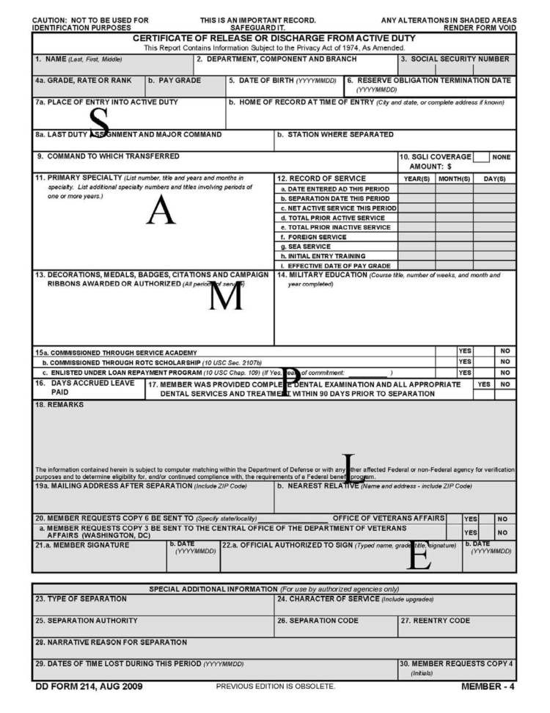
DD Form 214
Certificate of Release or Discharge
from Active Duty
Your DD 214 is the key to
unlocking all future benefits.
BEFORE TRANSITION:
Review the dates and locations of Service on your DD 214 CAREFULLY.
Have mistakes corrected.
Safeguard your DD 214!
RG, p. 13
Notes:
The final step of transition is the receipt of the DD Form 214 (DD 214)—Certificate of Release or Discharge from Active Duty
• Each service has a different process on when or how the service member will receive the DD214, explain how and when the service member can expect to receive their DD214.
• Each service member is responsible for ensuring the information on the DD214 is accurate.
• This is the MOST IMPORTANT MILITARY DOCUMENT the service member will ever receive. Tell them to take time to review it line by line to confirm accuracy! (For example, name, home of record, dates of service, overseas locations/dates, last duty assignment and rank.)
• The DD 214 is the key for a service member to unlock benefits. It provides proof of military service and is used to verify service for benefits.
• DD 214 is required to rejoin the military, claim veteran preference for employment, and for membership in veteran organizations.
• Store your DD 214 in a safe and accessible location known to your next of kin.
• STRESS the importance of reviewing thoroughly – it is extremely difficult to change once out of the service.

Slide 28
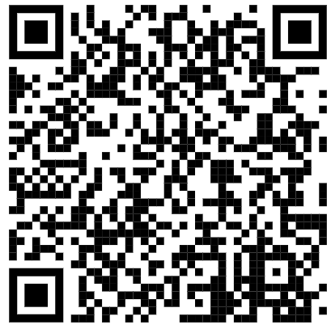
MY transition timeline
https://www.dodtap.mil/dodtap/rest/docs?filename=Managing_Your_Transition_Timeline.pdf
RG, p. 14
Notes:
To understand all the steps and topics to consider during your transition, the TAP partners collaborated on the Managing Your Transition Timeline or MY Transition Timeline.
• Found on DODTAP.mil, this single page PDF contains hyperlinks in blue to various resources and provides a basic timeline highlighting different elements to consider during transition.
• If time or internet access does not allow for the activity below, encourage participants to explore on their own.

Slide 29
MY TRANSITION “TO DO” LIST
Step 1:
Identify the TAP Courses and CRS you are required to complete and list them.
Initiate your DD 2648 and ITP.
Schedule a time to review your DD 214.
Create DS Logon and Login.gov accounts.
RG, p. 14

Slide 30
STEP 1: Plan for Your Transition
STEP 2:
Build Your Transition Team
STEP 3: Know Your VA Benefits
STEP 4: Plan for Health/Mental Care and Health Insurance
STEP 5: Plan for Civilian Employment/Vocational Training
STEP 6: Learn About Federal Employment
STEP 7: Plan for Further Education
STEP 8: Consider Starting a Business
STEP 9: Explore Additional Information and Benefits
STEP 10: Know Where to Go for Assistance
RG, p. 15

Slide 31
Installation Resources
YOUR
TRANSITION
TEAM
Military & Family Support Staff
Service Transition or TAP Office
VA Benefits Advisor
Chaplains, Health Professionals, Education Office
Off-installation Resources
American Job Centers - DOL
Vet Centers - VA
Military OneSource - DoD
Military and Veteran Service Organizations
RG, p. 15
Notes:
Off-Installation Resources
o American Job Center (AJC), DOL, provide free assistance to job seekers for a variety of career and employment related needs; Veterans have preference for AJC services over non-veterans.
o VA Vet Centers provide counseling as a confidential resource to you and your family as you transition.
o Military OneSource is a DoD information, referral, and assistance program providing confidential services worldwide, 7 days a week, 24 hours a day, at no cost to you, up to 365-days post-transition; within Military One Source there is an area specifically for transitioning SM.
o Military and Veteran Service Organizations (MSO/VSO) provide advocacy, education, and other support for the unique issues facing Veterans. Reference any VSO/MSO available on your installation or in your area that you work with.
COUNSELOR NOTE: Military One Source is available to Coast Guard active duty for 365-days post-separation or retirement. Prior to separation, Coast Guard may utilize CGSUPRT.COM for their referral and assistance.

Slide 32
INTERAGENCY PARTNERS
DoD TAP
DOL VETS
VA Veterans Resources
SBA Office of Veteran Business Development
RG, p. 17
Notes:
TAP is an inter-agency program, and each agency provides support to the transition program though development and delivery of the curriculum and maintaining websites to support transitioning service members and veterans.
• DoD TAP— Includes a DoD agency who supports TAP by developing the curriculum and providing guidance and policy;
And the services who implement TAP as best fits their culture and through delivery of the curriculum.
• DOL VETS—Provides Employment Fundaments for Career Transition, Employment Workshop, and Career and Credential Exploration. Also by maintaining the DOL Vets website, which provides resources on:
o Employment, Apprenticeships, Veterans Preference, Employment Resources for Spouses
• VA Veteran Resources—Provides VA Benefits and Services and maintains the VA website which is the entrance portal for all VA-related benefits and resources.
• SBA Office of Veterans Business Development (OVBD)—Provides the Boots to Business curriculum and provides support for small business programs for Veterans and their families or survivors through the OVBD website.

Slide 33
ADDITIONAL
SUPPORT SOURCES
Family Members
Military Colleagues
Veterans
Mentors
Social Network
National Resource Directory (NRD)
RG, p. 19

Slide 34
MY TRANSITION “TO DO” LIST
Step 2:
Identify one resource to use on the installation.
Identify one resource to use off the installation.
Research a previously unknown resource.
RG, p. 20

Slide 35
STEP 1: Plan for Your Transition
STEP 2: Build Your Transition Team
STEP 3:
Know Your VA Benefits
STEP 4: Plan for Health/Mental Care and Health Insurance
STEP 5: Plan for Civilian Employment/Vocational Training
STEP 6: Learn About Federal Employment
STEP 7: Plan for Further Education
STEP 8: Consider Starting a Business
STEP 9: Explore Additional Information and Benefits
STEP 10: Know Where to Go for Assistance
RG, p. 21
Notes:
This STEP will only highlight a few of the benefits provided by VA, many of which are time sensitive and may need attention prior to attending the VA Benefits and Services brief.
• During the VA Benefits and Services Brief, the VA Benefits Advisors will provide greater detail and be able to answer questions.
• Explain if they have questions about any VA benefit, you can connect them to the installation VA Benefits Advisor for assistance.

Slide 36
VA Benefits and Services
Personalized Career Planning and Guidance (PCPG)
VA Education Benefits
Veteran Readiness & Employment (VR&E)
VA Home Loan Guarantee
VA Life Insurance
State VA Offices
VA Solid Start
VA Disability
Benefits Delivery at Discharge
VA Health Care
VA Women’s Health
Transition Care Management (TCM)
VA Mental Health Care
RG, p. 21
Notes:
VA Benefits and Services (VABS) brief will cover a vast array of benefits and resources available from the VA, including but not limited to the topics listed on the slide.
• Do not expand on the topics on this list as VA information changes frequently and details about VA programs will be presented during VABS and not during Pre-Separation Counseling.

Slide 37
VA DISABILITY BENEFITS:
Benefits Delivery at Discharge
What
Benefits Delivery at Discharge (BDD) provides VA disability compensation (pay) from day of discharge.
Service members meeting the requirements SUBMIT the completed BDD claim within 180 – 90 days from discharge.
Meet with a VA Benefits Advisor to determine if this option is right for you.
Who
How
RG, p. 22
Notes:
Please be sure to include your health assessment part A or the claim will not be processes.
If making an appointment with local VA offices MUST CALL, email is no longer accepted.
During the mandatory VABS brief, an in-depth discussion is provided on VA disability. It will include:
o Navigation of the VA website for filing a claim.
o Documentation required to submit when filing your claim.
o Benefits Delivery at Discharge (BDD)
o Ways to file a claim to include BDD
▪ For BDD, the completed claim or application must be SUBMITTED between 180-90 days prior to separation. ▪ For submission to occur between 180-90 days, the service member needs to start gathering the necessary medical documentation as early as 12 – 18 months prior to separation due to necessary appointments to complete the application.
▪ No other VA disability has this time requirement. Those interested in pursuing BDD should speak with a VA Benefits Advisor as soon as possible to determine if they meet the requirements and understand the timeline.

Slide 38
TRANSFER OF BENEFITS
Failure to complete the obligated Service before separating may require any benefits used to be repaid.
Criteria for active-duty Service member to transfer Post-9/11 GI Bill benefits
Served a minimum of 6 years
Agree to add 4 more years of Service
Recipient of benefits has enrolled in DEERS
AND
AND
RG, p. 25
Notes:
VA education benefits will be discussed in detail during VABS and during the DoD Education Track: Managing Your Education.
• This is about transferred education benefits.
• ASK: Has anyone transferred their GI Bill benefits to a spouse or children? o If yes – ask if they have checked milConnect to ensure their separation date is AFTER the obligation is complete? The Obligation End Date is shown at the top of the page under “Sponsor” and on the “Approval Form.”
o STRESS that failure to complete the obligated service before separating will likely require any benefits that were used to be repaid in full.
o If no – let them know this is meant at a retention tool. As such, it is only available after 6 years of service and incurs a four-year obligation. If they do, they may need to reenlist or withdraw their separation/retirement papers.

Slide 39
STATE VA OFFICES
Assist in identifying and accessing benefits after separation or retirement.
Each state manages its own VA Office; therefore, each state’s level of assistance will vary.
https://www.va.gov/statedva.htm
RG, p. 29
Notes:
State VA Offices are there to assist with a wide range of county, state, and federal benefits related to education, employment, finance, health care, housing, legal assistance, recreation, taxes, and more.
• Each State manages its own State VA Office and benefit programs; therefore, some State VA Offices have a greater ability to assist.
• For more information on a specific state’s VA benefits, visit https://www.va.gov/statedva.htm. Click on a state for the locations of State VA Offices.
• FACILITATOR NOTE: Know the State VA benefits in your state. If you know the VA State Reps in your area, provide their contact information.

Slide 40
VA SOLID START
Follow up phone calls from VA at 90, 180, 365 days after separation.
Reminder emails with links to resources.
Update contact information at VA.gov prior to separation/retirement.
RG, p. 30
Notes:
Service members will receive phone call from the VA three times during the first year of separation around 90, 180, and 365 days after separation.
• In addition to the three phone calls, newly separated veterans receive reminder emails about upcoming calls with links to resources.
• To ensure receipt of these phone call/email, encourage service members to update their contact information at VA.gov prior to transition.

Slide 41
VA BENEFITS ADVISOR(S)
John France
Naval Weapons Station-Joint Base Charleston
Building 302 Office 1111
(Office) 843-794-4304 / (Cell) 571-461-8852
Jon.france.ctr@vatap.calibresys.com

Slide 42
MY TRANSITION “TO DO” LIST
Step 3:
Check to ensure obligation due to transfer of entitlement is complete.
Research GI Bill education benefit
Determine eligibility for BDD
Make appointment with VA Benefits Advisor
RG, p. 31

Slide 43
STEP 1: Plan for Your Transition
STEP 2: Build Your Transition Team
STEP 3: Know Your VA Benefits
STEP 4:
Plan for Health/Mental Care and Health Insurance
STEP 5: Plan for Civilian Employment/Vocational Training
STEP 6: Learn About Federal Employment
STEP 7: Plan for Further Education
STEP 8: Consider Starting a Business
STEP 9: Explore Additional Information and Benefits
STEP 10: Know Where to Go for Assistance
RG, p. 32

Slide 44
Required Health Assessments
MHS GENESIS Patientt Portal contains a Service Separation tab which provides the steps necessary to start the process.
SEPARATION HISTORY
AND PHYSICAL
EXAMINATION (SHPE)
OR
SEPARATION HEALTH ASSESSMENT (SHA)
AND
MENTAL HEALTH ASSESSMENT (MHA)
Either SHPE (DoD conducted) or SHA (VA conducted) is required prior to separation or release from active duty.
Either SHA (VA conducted) or SHPE (DoD conducted) is required prior to separation or release from active duty.
MHA is required prior to SHPE or SHA and will be included as part of the appointment.
SHA is required for VA disability claims.
!
Confirm your Service Treatment Record (STR) or Military Medical Record includes all medical aid received on AND off installation.
RG, p. 32
Notes:
Service members are required to complete a SHPE or SHA if they have served 180 days on active duty or 30 days in a contingency operation. If a service member is applying for disability, the DoD will accept the SHA—no need to complete both. RECOMMEND THEY DO COMPLETE BOTH – The SHA (VA) is done 6-8 months out with the SHPE closer to separation date, SM will have the option to document additional items that may not have been at the SHA.
• The SHPE and SHA facilitate:
o Documentation in the Service Treatment Record (STR) of the health status of separating service members
o Assistance in the transfer of care from the DoD to the VA
It is essential for the STR to be up to date prior to the medical exam to include summaries of any inpatient hospital care and mental health treatment provided during periods of active military service or related to conditions caused by military service.
• Mental Health Assessment (MHA) is required to complete prior to attending the SHPE or SHA appointment. The results of this online self-assessment will be addressed during the SHPE or Separation Health Assessment (SHA).
• Tricare online provides a Service Separation page with instructions, forms, and resources to help prepare for the SHPE/SHA.
FOR RESERVE:
• Reserve Component service members who deployed within two years may request a SHPE to document duty-related health conditions that may not have been captured during other physical exams.

Slide 45
DoD inTRANSITION PROGRAM
Available to ALL Service members regardless of length of Service or discharge status
No expiration date to enroll
Free, confidential coaching and assistance for Service members who require mental health services.
Automatically enrolled if seen by a behavioral health provider within 1 year of separation from active duty*
RG, p. 34
*May opt out
Notes:
DoD inTransition program is specialized coaching and assistance for military members who need access to mental health care.
• A service member who was seen within the last year for behavioral health, will be automatically enrolled in the program and will be contacted by a counselor. The service member can opt out.
• InTransition coaches answer questions about treatment options, provide information about community resources, and secure appointments with a behavioral health provider at the service member’s new location.
• Available to ALL military members regardless of length of service or discharge status.

Slide 46
VETERANS/MILITARY CRISIS LINE
Save this information in your phone to assist friends and family
Text: 838255
Dial: 988; Press 1
Chat: www.VeteransCrisisLine.net
RG, p. 35
Notes:
Veterans/Military Crisis Line is a Toll-free, confidential resource that connects service members and veterans and their families and friends with qualified VA responders for support when issues reach a crisis point, even if it is not a suicidal crisis.
• Receive free, confidential support 24 hours a day, 7 days a week, 365 days a year.
• Do not need to be registered with the VA or enrolled in VA health care.

Slide 47
SEXUAL ASSAULT
PREVENTION AND
RESPONSE
PROGRAM
Sexual harassment
Sexual assault
Intimate Partner Violence (IPV)
Contact your unit or installation SAPR Victim Advocate or Safe Helpline if you have been a victim of Sexual Assault.
RG, p. 36
Notes:
Sexual Assault Response Coordinator or SAPR Victim Advocate for those who have been victims of Military Sexual Trauma (MST) to include: o Sexual harassment
o Sexual assault
o Intimate Partner Violence (IPV)
• VA offers services to any veteran that is a victim of MST or IPV, regardless of disability rating.

Slide 48
TRICARE HEALTH CARE PLAN
Schedule an appointment with TRICARE representative.
Retirees who fail to enroll in TRICARE Prime or TRICARE Select and pay the premium will lose all TRICARE coverage.
TRICARE Plans:
TRICARE Prime or Select
Tricare for Life
TRICARE Retired Reserves
US Family Health Plan
RG, p. 37
Notes:
Health care options will vary depending on type of separation.
• TRICARE is but one option available; types of plans include:
o TRICARE Prime and Tricare Select – for Retirees; for those retiring from the military but under 65
o TRICARE for Life – for those 65 and over to supplement Medicare; Premiums are no longer paid for TRICARE but for Medicare; Medicare premiums are income-based
o TRICARE Retired Reserve – retired reservists
o US Family Health Plan -
o TRICARE Young Adult
• Schedule an appointment with the nearest TRICARE Representative to go over your benefits or visit the TRICARE website’s Plan Finder to learn about options based on your status, including TRICARE options for retirees. The Plan Finder allows you to enter specific information, answers questions and explains your options.
• Retirees who fail to enroll in TRICARE Prime or TRICARE Select and pay the premium may lose all TRICARE coverage and default to direct care, space available only coverage, provided in a military hospital or clinic. Any health care delivered outside of a military facility will not be covered.

Slide 49
TRANSITIONAL/TEMPORARY
HEALTH CARE COVERAGE
Continued Health Care Benefits Program (CHCBP)
Transitional Assistance Management Program (TAMP)
RG, p. 40
Notes:
If a separating service member needs health insurance, there are some options for Transitional Health Care Benefits:
• Continued Health Care Benefits Program (CHCBP) o Provides temporary health coverage for 18-36 months for the former service member and family when you lose eligibility for TRICARE or TAMP.
• Transitional Assistance Management Program (TAMP)
o To be eligible for the 180-day transitional medical and dental benefits, you must meet one of the requirements listed in the RG.
o If eligible, provides 180 days of premium-free TRICARE transitional health care benefits after regular TRICARE benefits end.
o STRESS the service member must meet the requirements to be eligible – not everyone is.

Slide 50
HEALTH INSURANCE
MARKETPLACE
At date of separation, health insurance ends with TRICARE, with few exceptions.
Health Insurance Marketplace is where anyone can find health insurance.
More information will be provided during the Financial Planning for Transition module.
Be sure to plan for separation when your
health insurance with Tricare may end!
RG, p. 43
Notes:
STRESS that healthcare insurance will end on the day of separation. Some may be able to transition to TAMP and VA, but most plans will require enrollment and payment.
• If you are not enrolled in VA benefits, TRICARE, or other veteran’s health coverage, you can get coverage through the Health Insurance Marketplace.
• The Marketplace helps uninsured people find health coverage by offering essential healthcare coverage (including pre-existing conditions) from multiple insurance carriers which allows you to pick the price and coverage you need. Income and household size are considered when calculating premium costs.
• Leaving the military is considered a “loss of qualifying health coverage” and allows you to enroll outside of the normal open enrollment period.
• More information on this topic will be provided during the Financial Planning for Transition TAP course.

Slide 51
MY TRANSITION “TO DO” LIST
Step 4:
Start the SHPE/SHA process through the DoD or VA website.
Determine eligibility/options for temporary or transitional insurance.
Research health insurance options.
Know the mental health resources.
RG, p. 43

Slide 52
STEP 1: Plan for Your Transition
STEP 2: Build Your Transition Team
STEP 3: Know Your VA Benefits
STEP 4: Plan for Health/Mental Care and Health Insurance
STEP 5:
Plan for Civilian Employment/Vocational Training
STEP 6: Learn About Federal Employment
STEP 7: Plan for Further Education
STEP 8: Consider Starting a Business
STEP 9: Explore Additional Information and Benefits
STEP 10: Know Where to Go for Assistance
RG, p. 44

Slide 53
DOL
EMPLOYMENT
TRACK:
Employment Workshop
(DOLEW)
Identifying Skills
Job Searching
Networking
Resume Building
Federal Hiring
Social Media
Branding
Applications
Interviews
Job Offers
EMPLOYMENT
CRS
Complete a resume or provide verification of employment
RG, p. 44
Notes:
Two-day workshop: DOLEW provides greater detail on transitioning to a civilian career to include identifying your career goals and skills, developing and building your personal brand, exploring federal hiring, preparing for interviews, receiving a job offer and negotiating the offer.
• Topics include:
o Identifying Skills
o Job Searching
o Networking
o Resume Building
o Federal Hiring
o Social Media
o Branding
o Applications
o Interviews
o Job Offers
• CRS: Complete a resume or provide verification of employment

Slide 54
DOL VOCATIONAL
TRACK:
Career and Credentialing Exploration (C2E)
Vocational Training
Career Clusters
Career Assessments
Resources
Labor Markets
Experience Opportunities
Credentials
Educational Goals
Career Action Plan
VOCATIONAL
CRS
Complete a comparison of technical training institution options
RG, p. 44
Notes:
Two-day workshop: C2E is for those who want to explore their interests, values, and aptitudes to make informed career decisions. It is ideal for those seeking to identify credentials and qualifications needed for various occupations of interest and includes information on the opportunity for and benefits of apprenticeships.
• Topics include:
o Vocational Training
o Career Clusters
o Career Assessments
o Resources
o Labor Markets
o Experience Opportunities
o Credentials
o Educational Goals
o Career Action Plan
• CRS: Complete a comparison of technical training institutions

Slide 55
EMPLOYMENT NAVIGATORS
Employment Navigators provide assistance with…
Self-Assessments
Skills Testing
Career Exploration
Identification of high-demand careers
Identification of necessary credentials
Review of detailed labor market information
Resume Review
Connections to partners for additional employment services
Looking for direction for your next career? Not sure how to identify your “good fit” career field?
We can help.
Schedule your appointment today.
Scan the QR code with your phone camera. Scroll down to schedule your appointment online.
For more information or to connect with an Employment Navigator, go to
https://www.dol.gov/agencies/vets/programs/tap/employment-navigator-partnership
Notes:
EN are trained employment counselors able to help you determine a good fit career path for a meaningful and lasting career.
• This is accomplished through one-on-one, personalized career assistance services, such as:
o Self-Assessment
o Skills Testing
o Career Exploration
o Identify High-demand Careers
o Identify Recommended/required Credentials
o Labor Market Information
o Resume Review
o Connections to partner

Slide 56
DOL Transition Employment Assistance
for Military Spouses
AND CAREGIVERS (TEAMS)
Your Next Move
Career Credentials
Entrepreneurship
Marketing Me
Resume Essentials
Federal Hiring
Flexible Job Options
Interview Skills
LinkedIn Profiles/Job Search
Salary Negotiations
RG, p. 45
Notes:
Available through CNIC LMS is Navy Spouses in Transition (NSiT)
DOL also provides assistance for military spouses seeking employment before, during or after transition and has created a robust catalogue of TEAMS workshops specifically focused on spouse employment needs.
• Courses are offered online with a live instructor at various times/dates to allow for maximum participation by military spouses.
• Course descriptions and registration instructions are included in the RG.
• Transition Employment Assistance for Military Spouses (TEAMS)

Slide 57
DOL Resources
American Job Centers (AJC)
Priority of Service
State Job Banks
Unemployment Compensation
Career One Stop website
O*NET
Interest Profiler
My Next Move for Veterans
RG, p. 47
Notes:
Career One Stop—DOL website that provides employment-related resources and information to help identify potential careers using current military occupation and explore training opportunities for certifications and licenses.
• American Job Center (AJC)— provides employment, education, and training services through local, state, and federal programs. o Priority of Service—veterans and their family members receive priority of service before non-veteran individuals at AJCs; must identify as a veteran.
o State Job Banks—each state has its own free job board that allows searches for jobs in specific states/cities.
o Unemployment Compensation (UCX)—research the state where UCX will be filed to determine requirements and eligibility.
• O*NET- A database contains hundreds of standardized and occupation-specific descriptors on almost 1,000 occupations covering the entire U.S. economy.
It also includes:
o Interest Profiler (IP)—identifies skills, abilities, and interests and careers where those skills and abilities are used.
o My Next Move for Veterans—Search careers by using keywords, branch of service, and the military occupational code (MOC).

Slide 58
CREDENTIALING
Licenses
Certifications
Credentialing Opportunities On-Line (COOL)
MilGears
RG, p. 49
Notes:
Credentialing is the generic term for licenses and certification. Sometimes credentials are legally required to perform certain jobs, and employers may give preference in hiring or higher salaries to candidates with credentials. Types of credentials include:
o Licenses—granted by a governmental agency to practice a specific occupation, e.g., medical license for doctors, state teaching certification for teachers, etc.
o Certifications—issued by a non-government agency, association, or private-sector company and may be required or optional.
o Certificates are not the same as certifications as they document completion of a course, but do not show proof of competency and are not regarded highly by most employers.
• Credential Resources: o Credentialing Opportunities On-Line (COOL)—determines if military training or experience can be used toward a license or credential.
o MilGears—uses military training, duty assignments, off-duty education, credentialing, and in-service/post-service goals to create a personal assessment of civilian credentials and career opportunities.
• Additional credentialing information is included in the DOL Vocational Track: Career and Credential Exploration (C2E).

Slide 59
GAINING EXPERIENCE
Apprenticeships/OJT
United States Military Apprenticeship Program (USMAP)
Volunteering
AmeriCorps
Peace Corps
RG, p. 52
Notes:
Apprenticeships—perform work for an employer and gain on-the-job training (OJT) while being paid a wage; may attend classroom instruction prior to OJT or at the same time.
• United States Military Apprenticeship Program (USMAP)—a formal military training program that allows service members to improve their job skills and complete civilian apprenticeship requirements while on active duty; provided at no cost and requires no off-duty hours.
• Volunteering—Increases the likelihood of gaining employment and provides opportunities to gain experience, build a resume, and network in a specific career field. o AmeriCorps is a national service/volunteer program providing valuable experience helping communities solve tough challenges.
o Peace Corps is an international volunteer program aiding global communities on prioritized projects.

Slide 60
DoD SkillBridge
BENEFITS:
Train and learn with an industry partner
Continue military pay and benefits
REQUIREMENTS:
Meet Service requirements
Within 180 days of separation
Obtain unit commander approval
Find a SkillBridge Opportunity
Skillbridge.osd.mil/locations.htm
RG, p. 56
Notes:
• Must be within 180 days of separation date to participate.
• Requires approval from first field-grade level Commander.
• Each service has individual guidelines and requirements for participation.
• Contact the local TAP office for more information.
Share the monthly SkillBridge Briefs offered through CNIC LMS Zeiders. (Flyer)

Slide 61
UNIFORMED SERVICE EMPLOYMENT AND REEMPLOYMENT RIGHTS ACT (USERRA)
Federal law that establishes rights and responsibilities for uniformed Service members and their civilian employers
Active Duty, National Guard, and Reserve Members covered by USERRA
More information provided during DOL modules
RG, p. 56
Notes:
USERRA is a federal law that establishes rights and responsibilities for uniformed service members and their civilian employers.
• Interpreted, administered, and enforced by DOL-VETS who will provide details during the DOL courses.

Slide 62
MY TRANSITION “TO DO” LIST
Step 5:
Consider taking one of the two DOL tracks
Research credentials in chosen career field
Determine if SkillBridge is an option
RG, p. 57

Slide 63
STEP 1: Plan for Your Transition
STEP 2: Build Your Transition Team
STEP 3: Know Your VA Benefits
STEP 4: Plan for Health/Mental Care and Health Insurance
STEP 5: Plan for Civilian Employment/Vocational Training
STEP 6:
Learn About Federal Employment
STEP 7: Plan for Further Education
STEP 8: Consider Starting a Business
STEP 9: Explore Additional Information and Benefits
STEP 10: Know Where to Go for Assistance
RG, p. 58

Slide 64
FEDERAL EMPLOYMENT OPPORTUNITIES
Feds Hire Vets and USAJobs
Veterans Preference
Special Appointing Authority for Veterans
Transitioning to
Federal
Employment
TAPEvents.mil/courses
Notes:
For federal employment, you should explore USAJOBS.gov. This is the official website for federal jobs. Also, there is Feds Hire Vets, which includes 24 agencies interested in hiring veterans with each providing a veteran representative within the agency.
During Application Process:
• Veterans Preference—a rating system that gives Veterans who qualify additional consideration over non-veterans during the review process for federal employment. o Eligibility is based, in part, on dates of service, receipt of a campaign badge, and service-connected disability.
o Not all Veterans are eligible for preference.
• Special Appointing Authority for Veterans
The Office of Personnel Management (OPM) MLC course, Transitioning to Federal Employment, is available online as part of Transition Online Learning.
More information on federal hiring will be provided during DOL Employment fundamentals for Career Transition and the DOL Employment Track: Employment Workshop.

Slide 65
180-Day Restriction on DoD
Employment of Military Retirees
POST-MILITARY
EMPLOYMENT
RESTRICTIONS
Post-Government (Military) Service
Employment Restriction Counseling
RG, p .60
Notes:
Retiring service members are under a 180-day restriction for employment within DOD o Applies only to federal employment in DoD.
o Restriction requires a 180-day waiting period before a military retiree can be hired into the DoD.
o Exceptions may be granted.
• Post-Government (Military) Service Restriction Counseling o DoD components are required to provide counseling on Federal and DoD Government service employment restrictions to military members who are leaving active-duty service.
o Counseling is required and cannot be declined; written acknowledgment of the restrictions is required by all service members.

Slide 66
MY TRANSITION “TO DO” LIST
Step 6:
Visit the Feds Hire Vets website.
Review special hiring authorities to determine eligibility.
Take the Transition to Federal Employment course on TAPEvents.mil.
Receive counseling on government restrictions to employment.
RG, p. 62

Slide 67
STEP 1: Plan for Your Transition
STEP 2: Build Your Transition Team
STEP 3: Know Your VA Benefits
STEP 4: Plan for Health/Mental Care and Health Insurance
STEP 5: Plan for Civilian Employment/Vocational Training
STEP 6: Learn About Federal Employment
STEP 7:
Plan for Further Education
STEP 8: Consider Starting a Business
STEP 9: Explore Additional Information and Benefits
STEP 10: Know Where to Go for Assistance
RG, p. 63

Slide 68
DoD EDUCATION
TRACK:
Managing Your (MY) Education
Education Terms
Reasons for Earning a Degree
Choosing a Field of Study
Degree Options
Choosing an Institution
Gaining Admission
Transfer Credit
Funding Options
EDUCATION
CRS
Complete a comparison of higher education institution options
RG, p. 63
Notes:
Assists service members and their dependents* with identifying the higher education requirements that support their personal career goals.
• Information on both undergraduate and graduate degrees is included in the course.
• The two-day workshop includes the following topics: o Education terms
o Reasons for earning a degree
o Choosing a field of study
o Degree options
o Choosing an institution
o Gaining admission
o Transfer credit
o Funding options
• CRS: Complete a comparison of higher education institution options
*Spouses and dependents are encouraged to attend the DoD Education Track, especially if they are using GI Bill education benefits.

Slide 69
EDUCATION ASSISTANCE RESOURCES
Service Education Counselors resources:
College level-testing
Veterans’ Benefits
Tuition Assistance
Financial Aid Assistance
Deferments for military service
DANTES sponsored resources:
Kuder Journey
Online Academic Skills Training for College Prep/Placement Tests
CLEP or College Credit-by-Exam
Joint Service Transcript (JST)
Community College of Air Force (CCAF) Transcript
RG, p. 63
Notes:
Education counselors provide information for undergraduate, graduate, and certificate programs as well as information on:
o College level testing
o Veterans’ benefits
o Tuition Assistance
o Financial Aid
• DANTES-sponsored programs used by Service Education Counselors include:
o Career exploration, e.g., Kuder Journey
o Academic Skills Training for College Preparation ▪ Online Academic Skills Course (OASC)—lessons to increase knowledge in math, science, reading comprehension, and vocabulary
▪ College Placement Skills Test (CPST)—preparation for college entrance and placement exams.
o College-Level Examination Program® (CLEP)/DANTES Subject Standard Tests (DSST)—tests which allow college credit to be earned for existing knowledge through an exam.
• Joint Service Transcript (JST)—lists military education and training and provides credit recommendations.
• Community College of the AF (CCAF) regionally accredited community college to promote education within the Air Force.

Slide 70
STATE AND
FEDERAL PROGRAMS
State and Local Educational Benefits
Department of Education Federal Programs/Benefits:
Federal Student Aid—Complete the FAFSA by October 1st
Veterans Upward Bound Program
RG, p. 65
Notes:
State and Local Ed Benefits—some states have additional education benefits such as free or discounted tuition at state schools for veterans and/or families.
• Federal education programs
• Programs administered by the U.S. Department of Education (ED)
o Federal Student Aid—Complete the Federal Application for Federal Student Aid (FAFSA) is available to apply starting October 1st for the next school year.
▪ FAFSA is required for grants, loans, and work-study programs
▪ Can be used in addition to the GI Bill
o Veterans Upward Bound Program— encourages, empowers, and prepares college-bound veterans for the rigors of post-secondary training. Not available at all colleges, need to research to determine if the college participates.

Slide 71
MY TRANSITION “TO DO” LIST
Step 7:
Consider taking the Education Track: Managing Your Education.
Visit your Education Counselor.
Research State Education Benefits for veterans.
Download JST
RG, p. 66

Slide 72
STEP 1: Plan for Your Transition
STEP 2: Build Your Transition Team
STEP 3: Know Your VA Benefits
STEP 4: Plan for Health/Mental Care and Health Insurance
STEP 5: Plan for Civilian Employment/Vocational Training
STEP 6: Learn About Federal Employment
STEP 7: Plan for Further Education
STEP 8:
Consider Starting a Business
STEP 9: Explore Additional Information and Benefits
STEP 10: Know Where to Go for Assistance
RG, p. 67

Slide 73
SBA ENTREPRENEURSHIP
TRACK:
Boots to Business (B2B)
Fundamentals
Opportunities
Market Research
SmallBiz Economics
Legal
Financing
ENTREPRENEURSHIP
RG, p. 67
Notes:
Highlight our local VBOCs B2B workshops offered locally if unable to attend one of MFRCs.
o Identifying business opportunities
o Constructing a business plan
o Mapping strategies for success
o Launching a new business enterprise

Slide 74
Veteran entrepreneurship is supported by SBA, VA, and DoD through the following legislation and programs:
SBA—Small Business Development Act 1999 created goals for veteran contracts.
DoD Procurement Technical Assistance Center Program helps businesses pursue government contracts.
VA Small and Veteran Business Program provides support to small and veteran businesses.
VETERANS FEDERAL
PROCUREMENT
OPPORTUNITIES &
ASSISTANCE
RG, p. 68
Notes:
Veteran entrepreneurship is supported by SBA, VA, and DoD through legislation and programs:
o SBA—Small Business Development Act 1999 created veteran contract goals.
o DoD Procurement Technical Assistance Center Program helps businesses pursue government contracts.
o VA Small and Veteran Business Program provides support to small and veteran businesses.

Slide 75
STEP 1: Plan for Your Transition
STEP 2: Build Your Transition Team
STEP 3: Know Your VA Benefits
STEP 4: Plan for Health/Mental Care and Health Insurance
STEP 5: Plan for Civilian Employment/Vocational Training
STEP 6: Learn About Federal Employment
STEP 7: Plan for Further Education
STEP 8: Consider Starting a Business
STEP 9:
Explore Additional Information and Benefits
STEP 10: Know Where to Go for Assistance
RG, p. 69

Slide 76
EXTREMISM
REPORTING METHODS
For an emergency, call 911
FBI-Tips Electronic Tip Form: https://tips.fbi.gov/
Local FBI offices: https://www.fbi.gov/contact-us/field-offices
RG, p. 69
Notes:
• When you began your military service, you took an oath to support and defend the Constitution of the United States against all enemies, foreign and domestic.
• You have been trained to avoid and report extremist groups and activities, which go against the fundamental principles of that oath.
• As you leave military service, guard against attempts to be radicalized, continue to take a stand against extremism organizations, and report suspicious activities to the proper authorities.
• Reporting methods are listed on the screen and in the RG.

Slide 77
IMMIGRATION STATUS
Request information on immigration status and expedited naturalization:
DD 2648 eForm—Opt in
DD 2648 printed form—Write an “opt in” election in Section XI – REMARKS, item 48
RG, p. 69
Notes:
Immigration Status—Service members may request additional information on immigration status and expedited naturalization during IC.
o DD eForm 2648—includes an option to “opt in” to receive more information
o DD2648 printed form—allows for an “opt in” election to be written in Section XI—REMARKS, item 48
• If immigration information has not been provided, have participants speak with a TAP counselor, contact the local legal office, or reach out to the U.S. Citizenship and Immigration service at the website provided in the RG.

Slide 78
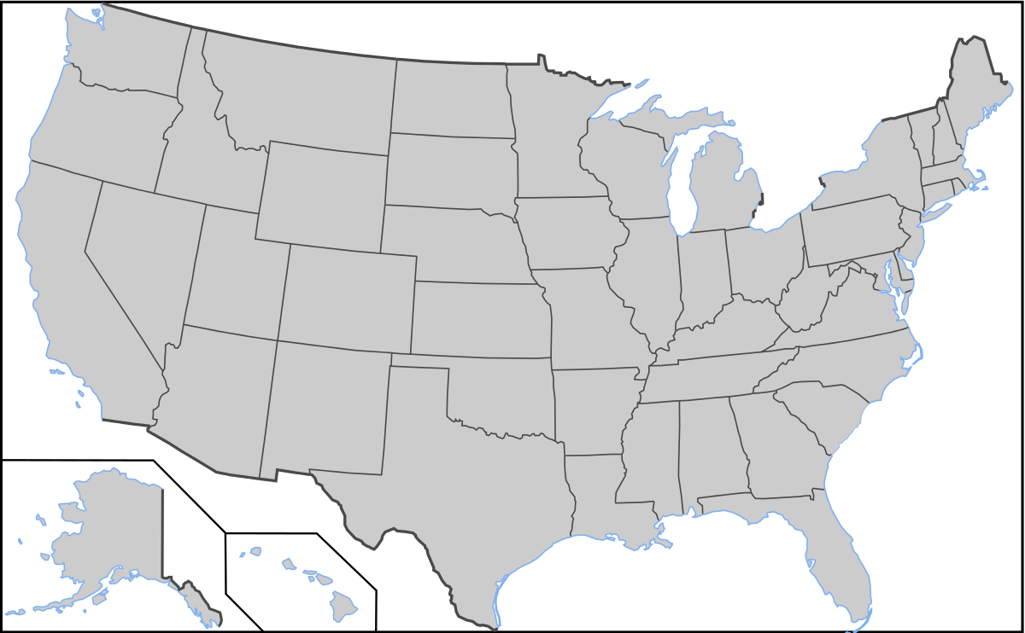
Opt-in FOR STATE information
1
Opt-in with your civilian email on the DD 2648
Indicate the state or states where you may live after transition
State representatives will contact you with information on employment, housing, education, etc.
2
3
RG, p. 70
Notes:
During the IC and initiating of the DD 2648, SM were offered the opportunity to share their email with the state or states to which they may be moving.
• Stress this is Opt-in only and the email will be shared only with the state to provide information specific to that state.
• Each State will determine what is to be provided, but may include: o Employment information
o Education information
o Housing information
o Resources specific to that state
• To receive State-specific information:
1. List your civilian email on the DD 2648.
2. Indicate the state or states where you may live after transition.
3. State Representatives will contact you with information on employment, housing, education, etc.

Slide 79
SEPARATION PAY
Separating: based on type of separation, reason for separation and vary greatly from person to person.
Final Pay:
Will be reduced by any outstanding balances/debts owed.
Service member is responsible for repayment of all debts, to include overpayment.
RETIREES: Final pay will be delayed to ensure all debts are cleared.
IMPORTANT TO NOTE WHEN RECEIVING SEPARATION PAY:
If receiving separation pay, and then become eligible for disability retired pay, the entire amount separation pay will recouped.
The separation pay debt will be repaid using the disability pay. You will receive the disability pay once the repayment is complete.
RG, p.70
Notes:
Separation Pay is available if being involuntarily separated or released from active duty.
• Separating: Separation pay eligibility and amounts are determined by the type of separation, reason for separation, and vary from person to person.
• Final Pay:
o A final pay will include any earned entitlements and pay for accumulated leave minus any outstanding debt – to include unearned bonus recoupment.
o Transactions already in progress could result in overpayment; any overpayments or outstanding debts are the responsibility of the service member.
RETIREES: Final pay will be delayed due to DFAS holding the final pay to verify all debts have been paid.
Separation Pay and Disability Retired Pay: If a service member received separation pay and were then awarded disability retired pay, the entire amount of separation pay will be recouped. VA disability payments will be used as repayment. Service member will start receiving disability payments when the entire separation pay amount has been recouped

Slide 80
ADDITIONAL INFORMATION
Thrift Savings Plan (TSP)
Survivor Benefit Plan (SBP)
Legal Assistance
Military Protections/Tax Benefits
Travel/Transportation Allowances
Permissive TDY/Excess Leave
Housing Assistance/Homelessness
Voting Assistance
Adaptive Tools for Service Members
Commissary, Exchange, MWR
RG, p.71
Notes:
• Thrift Savings Plan (TSP)—No matter if you separate or retire, you will retain your TSP account, a decision needs to be made as to what to do with the funds; options will be covered more fully in the financial planning for transition.
• Survivor Benefit Plan (SPB)—Retirees only—make an appointment with a financial counselor to discuss your financial situation and SBP.
• Legal Assistance—Post-transition you may or may not have access to free legal assistance; utilize legal assistance to address legal matters prior to separation or retirement.
• Military Protections and Tax Benefits -After transition, many military protections, such as Military Lending Act, Servicemembers Civil Relief Act and tax benefits of non-taxable entitlements will no longer apply.
• Travel and Transportation Allowances—The final move for separation/retirement is different from the other moves, with additional guidelines on transportation and allowances. For more information, contact the Personal Property or Transportation Office to schedule a personalized appointment.
• Permissive Temporary Duty (PTDY) and Excess Leave (EL)—
o PTDY or EL may be authorized for the purpose of job search and house hunting activities.
o Not available for those voluntarily separating at ETS or involuntarily separating under OTH.
o For additional information contact your personnel office. Your unit commander can provide approval.
• Voting Assistance—Post-transition, a SM is no longer covered by the Uniformed and Overseas Citizens Absentee Voting Act (UOCAVA) unless remaining or moving overseas. Update information to vote locally.
• Commissary, Exchange and Morale, Welfare, and Recreation (MWR) Benefits— Depending on your separation status, honorably or general discharged Veterans may be eligible for commissary, exchange, and/or MWR benefits.

Slide 81
MY TRANSITION “TO DO” LIST
Step 8/9:
Consider taking the Entrepreneurship Track: Boots to Business.
Review states for Opt-In and research state veteran benefits.
Research SPB options.
Update legal documents.
Determine eligibly for PDTY/EL.
RG, p. 79

Slide 82
STEP 1: Plan for Your Transition
STEP 2: Build Your Transition Team
STEP 3: Know Your VA Benefits
STEP 4: Plan for Health/Mental Care and Health Insurance
STEP 5: Plan for Civilian Employment/Vocational Training
STEP 6: Learn About Federal Employment
STEP 7: Plan for Further Education
STEP 8: Consider Starting a Business
STEP 9: Explore Additional Information and Benefits
STEP 10:
Know Where to Go for Assistance
RG, p. 80

Slide 83
TAP TRANSITION
ONLINE LEARNING (TOL)
Managing Your (MY) Transition
MOC Crosswalk
Financial Planning for Transition
VA Benefits and Services
Employment Fundamentals for Career Transition
www.TAPevents.mil
DOL Employment Track: Employment Workshop (DOLEW)
DOL Vocational Track: Career and Credential Exploration (C2E)
DOD Education Track: Managing Your (MY) Education (MYE)
SBA Entrepreneurship Track: Boots to Business (B2B)
RG, p.80
Notes:
STRESS that these courses DO NOT replace an inperson class.
If a service member or family member wants to take a TAP refresher, TAP curriculum courses are available at any time during and after transition in the TAP Transition Online Learning (TOL) virtual environment. These courses and the accompanying Participant Guides and handouts can be accessed without a CAC at: https://TAPevents.org/courses.

Slide 84
MILITARY LIFE CYCLE (MLC) COURSES
Apprenticeship
Community Integration Resources
Disability Compensation
Other Than Honorable
Transitioning to Federal Employment
Reserve Component Dual Payments
Social and Emotional Health Resources
Survivor and Casualty Assistance
VA Benefits 101
VA Education Benefits
VA Home Loan Guaranty Program
VA Life Insurance Benefits
Vet Centers
RG, p.81
Notes:
• Military Life Cycle (MLC) courses—can be used at any time to gain additional information on specific topics, i.e., VA home loans before buying a house, VA education benefits before enrolling in college courses, etc.
• Available at Transition Online Learning (TOL) for use by active-duty service members, veterans, spouses, dependents, and care givers.
• No CAC required for access.

Slide 85
MY TRANSITION “TO DO” LIST
Step 10:
Attend TAP Courses; Complete CRS assigned
Start VA Disability process.
Ensure any Service obligation will be complete by separation/retirement date.
Plan for Healthcare.
Consider a SkillBridge.
Connect with an employment resource.
Utilize TAPEvents.mil to review courses or retrieve participant guides.
Download the TAP Interagency Website Guide
RG, p. 82

Slide 86
Embrace the journey. Embrace the change. Growth doesn’t come from things staying the same.
~Unknown

Slide 87
QUESTIONS?
Reminder:
We are here to help YOU! If you have any questions at any point during your transition, please let us know.

Slide 88
NEXT STEPS
Get Credit for attending Pre-Separation Transition Counseling
Log into https://www.dodtap.mil/ (Continue to the MilConnect Login)
Click on Correspondence and Documentation
Click on DOD TAP
Scroll down to ”eForm”
Verify that all personal information and required fields are completed and correct.
(If you completed an Initial Counseling (IC), but Section I, Blocks 19-22 not populated to reflect date of completion and results, you will need to consult with the Transition Counselor that facilitated your IC session before you can provide digital signature on the DD 2648 eForm.
Final screen click “Save” (Wait about 30 seconds then ”Click Here to Sign and Lock)
A TAP Counselor will sign your eForm and schedule you for your requested TAP date
Email confirmation will be sent to you within 24-48 hours, please be patient

